Slide 1
SABR 2018
What the hell is that?

Slide 2
67 year old Woman with OA

Slide 3
Immediate Post -OP

Slide 4
Intra-op

Slide 6
40 year old man

Slide 8
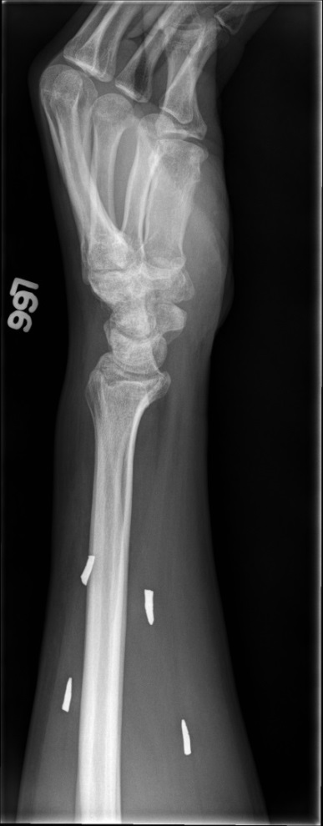

Slide 10
53 year old man with h/o melanoma

Slide 13
Lung cancer metastasis (non small cell)
Mets can (and do) look like anything

Slide 14
63 year old man with LBP x 1 yr

Slide 20
Solitary Plasmacytoma
“very rare” in sacrum – 2-4% of all solitary plasmacytoma cases
Extremely vascular so be careful if asked to biopsy
Usually show only “slightly” expanded growth pattern
Often have low signal on T2-weighted MRI

Slide 21
37 year old man

Slide 23
Triton Tumor
MPNST with rhabdomyoblastic differentiation
Usually arise from large deep neurofibroma in patient with NF1
MPNST 5-10% of all soft tissue sarcomas
Triton tumor @ 5% of all MPNST
Described by Masson in 1932
Received its pseudonym from experiments by Locatelli on the “Tri- ton” salamander.
By transplanting the sciatic nerve onto the dorsal surface of this salamander, Locatelli was able to induce the growth of both neural and muscular elements in the form of a supranumerary limb; thus, he demonstrated an intimate developmental relationship between these two tissues

Slide 24
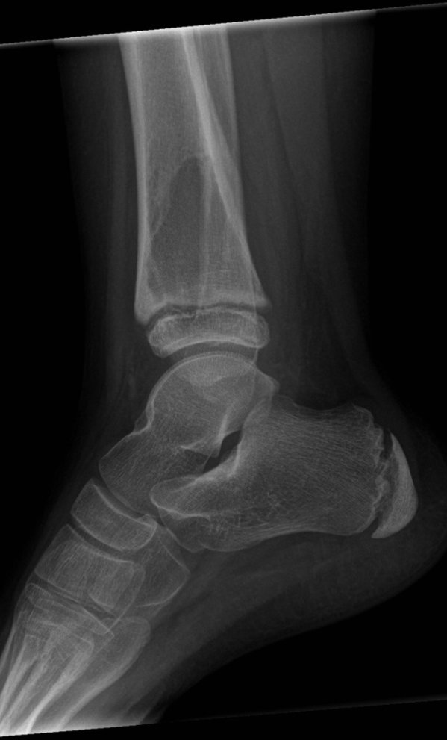
10 year old boy

Slide 32
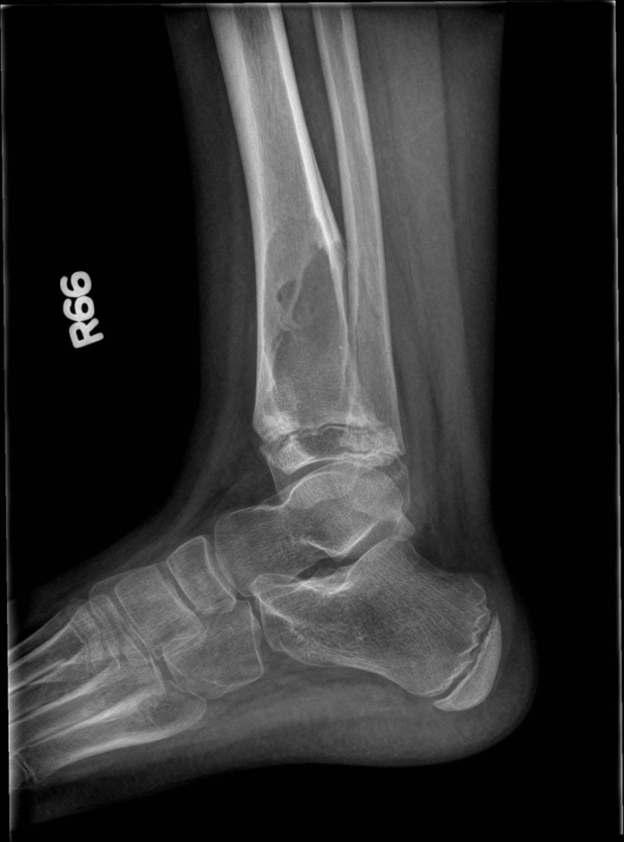

Slide 33
Bcor Sarcoma
Small round blue cell tumor (“subset” of Ewing’s)
Initially described in 2012
Fusion of BCOR and CCNB3 genes
BCOR – BCL6 interacting corepressor
CCNB3 – cyclin B3
Both bone and soft tissue primaries
Treatment and survival similar to Ewing’s

