Slide 1
History of SABR
Society of Academic Bone Radiologists

Slide 2
Initial Exploratory Meeting September 14-16, 2007
Attended by; Eva Escobedo, John Hunter, Mike Mulligan
At the Lodge at Sonoma

Slide 4
Name Game

Slide 5
Additional Members Born from the BORG (Bone Online Radiology Group)

Slide 6
BORG Members
John and Eva
Mike Mulligan
Stacy Smith
[Chuck Resnik]
Kirk Davis
Mike Tuite
Tom Martin
[Andy Sonin]
Steve Hatem
Mark Anderson
Dave Tsai
Ranjeet Singh
Mike Richardson
Jim Choi
Eric Brandser
Mark Murphey
Ted Miller
[Chris Beaulieu]

Slide 7
Organizational Meeting 2008
March 11, 2008 Palm Springs, CA (during SSR meeting)

Slide 8
Eric Brandser, Kirk Davis, Eva Escobedo, John Hunter,
Mike Mulligan, Mike Richardson, Stacy Smith, Dave Tsai

Slide 10
First Officers and Committees

Slide 11
Bylaws

Slide 12
Incorporated March 28, 2008

Slide 13
Website
Thank you Mike Richardson !!!

Slide 14
Logo Wars 2008 - 2014

Slide 15
Logo Wars

Slide 16
Logo Wars Ended 2014/15

Slide 18
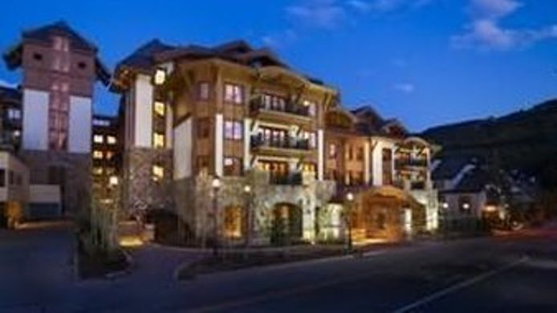
Vail 2008
July 24 – 25 Vail Plaza Hotel (pizza dinner)

Slide 19
Pizza Party #1

Slide 20
First Meeting Program

Slide 21
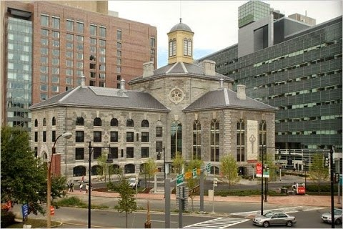
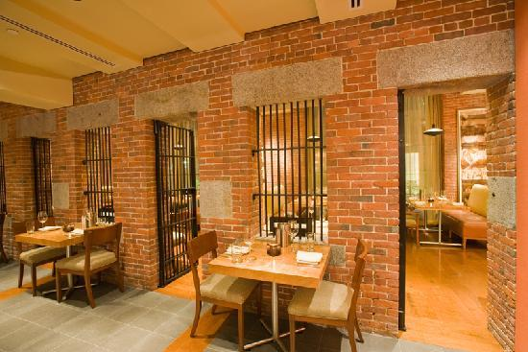
Boston 2009
July 29 – 31 Liberty Hotel (pizza dinner)

Slide 22
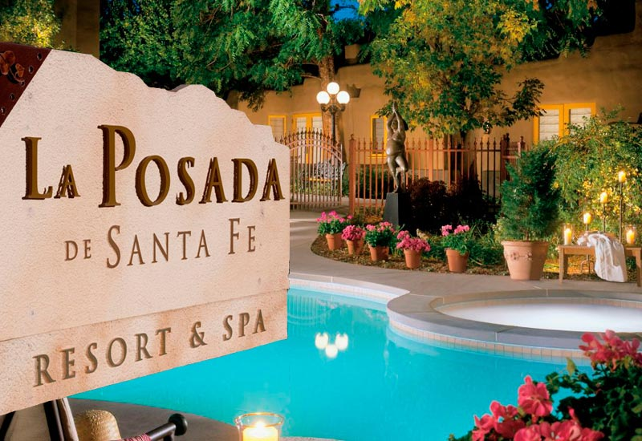
Santa Fe 2010
July 28 – 30 La Posada Resort & Spa (dinner at Rooftop Pizzeria – Santa Fe Arcade)

Slide 23
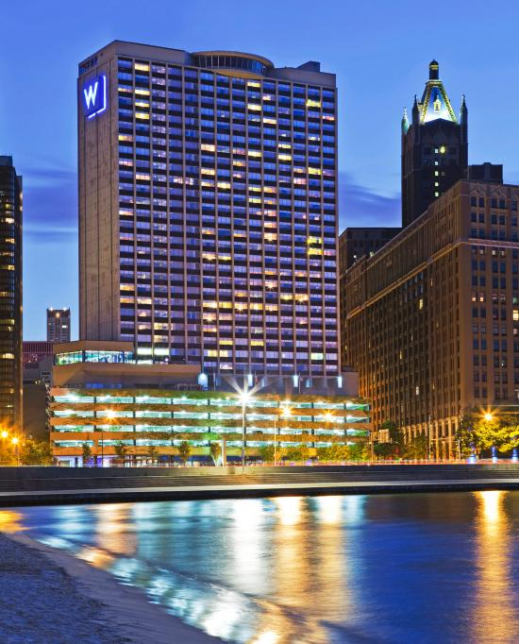
Chicago 2011
July 27 – 29 The W Hotel Lakefront (pizza dinner in the hotel)

Slide 24
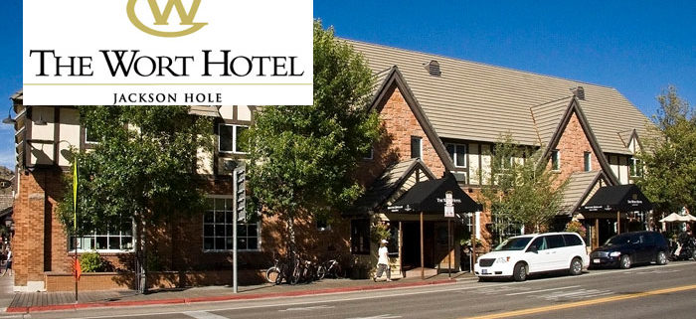
Jackson Hole 2012
July 25 – 27 The Wort Hotel

Slide 25
The Wort Hotel

Slide 26
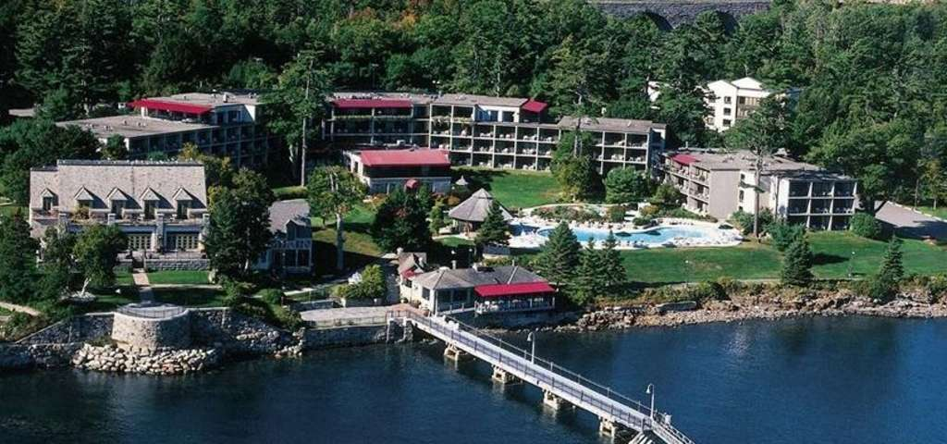
Bar Harbor 2013
July 24 – 26 Regency Hotel (Lobster dinner at

Slide 27
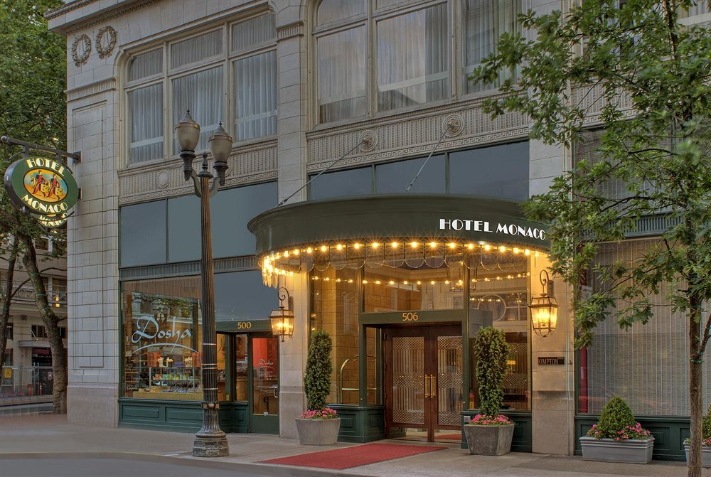
Portland 2014
July 23 – 25 Hotel Monaco (dinner in Red Star Club Room in hotel)

Slide 28
Portland Meeting Program

Slide 30
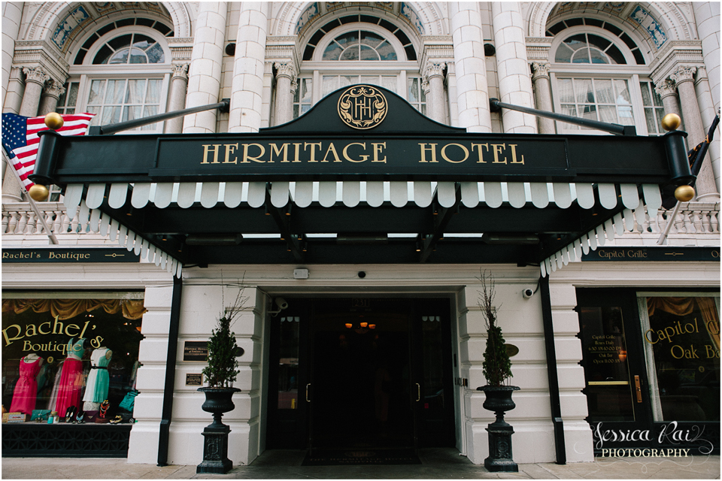
Nashville 2015
July 29 – 31 The Hermitage Hotel (dinner at Nashville Sounds Baseball Park)

Slide 31
The Hermitage Hotel

Slide 32
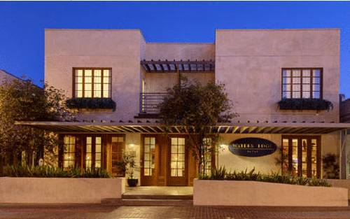
Tiburon 2016
July 20 – 22 Waters Edge Hotel (dinner at Severino’s Restaurant)

Slide 33
Waters Edge Hotel Deck

Slide 34
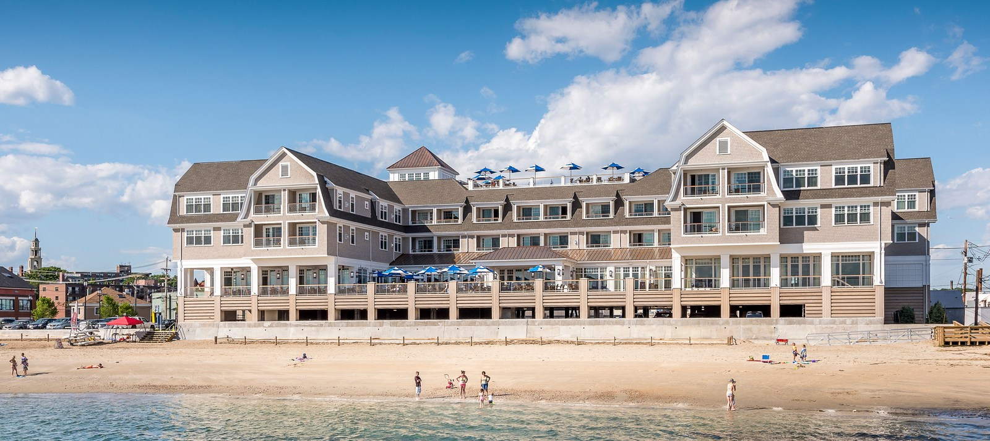
Gloucester 2017
July 26 – 28 Beauport Hotel (Clambake dinner in hotel)

Slide 35
Beauport Hotel Roof Top Pool

Slide 36
SABR Meetings and Members
Sonoma, CA – September 2007 – Eva Escobedo, John Hunter, Mike Mulligan
La Quinta, CA – March 2008 – Eva, John, Mike, Eric Brandser, Kirk Davis, Mike Richardson,
Stacy Smith, Dave Tsai
BORG clan additions – Mark Anderson, Jim Choi, Steve Hatem, Tom Martin,
Ted Miller, Mark Murphey, Ranjeet Singh, Mike Tuite
1) Vail, CO – July 2008 – Donna Blankenbaker (11 other attendees)
2) Boston, MA – July 2009 – Don Flemming (11 other attendees)
3) Santa Fe, NM – July 2010 – Jon Jacobson, Bob Lopez, Cat Roberts (13 other attendees)
4) Chicago, IL – July 2011 – Felix Chew, Tim Mosher, Kambiz Motamedi (14 other attendees)
5) Jackson Hole, WY – July 2012 – Laura Fayad, Mike Recht, Carl Winalski (13 other attendees)
6) Bar Harbor, ME – July 2013 - Robert Boutin (13 other attendees)
7) Portland, OR – July 2014 – Doug Goodwin, Corrie Yablon (15 other attendees)
8) Nashville, TN – July 2015 – Laura Bancroft (12 other attendees)
9) Tiburon, CA – July 2016 – Behrang Amini, Miriam Bredella (12 other attendees)
10) Gloucester, MA – July 2017 – Francesca Beaman, Soterios Gyftopoulos, Joel Newman, Scott Stacy
(31 active members after Gloucester meeting, 8 other inactive/former members)

Slide 37
Members Home Cities
2
1
3
3
2
2
1
2
1
2
1
3
1
1
1
1
1
1
1
1
1

Slide 38
Meeting sites 2008 - 2018
6 Bar
Harbor
7 Portland
10 Gloucester
5 Jackson
Hole
2 Boston
9
T
i
b
u
r
o
n
11
Tahoe
4
C
h
i
c
a
g
o
1 - Vail
Nashville 8
3 Santa Fe

Slide 39
Presidents
Mike Mulligan – 2008 - 2010
Eric Brandser – 2010 – 2012
Mark Anderson – 2012 – 2014
Ted Miller – 2014 - 2016
Kirk Davis – 2016 – 2018
Don Flemming – 2018 - 2020

Slide 40
Current Officers
Kirk Davis – President
Don Flemming – President-elect
Kambiz Motamedi – Secretary
Cat Roberts - Treasurer

