Slide 1
SABR meeting 2019
Metabolic conundrums?
Metabolic menagerie & mimics

Slide 2
Definition of conundrum
1a : an intricate and difficult problem

Slide 3
75 year old man referred for an abnormality in the soft tissues in his anterior compartment of his lower leg

Slide 5
Diagnosis?

Slide 6
Diabetic myonecrosis mimic
“He was shot in 1962 in the femoral artery. He was at risk for losing his lower extremity, but they were able to save his leg. His artery was repaired. He states that he had no circulation in his leg distal to the thigh for about 18 hours.”

Slide 8
59 year old man with “mass”
PD
Fat sat T2

Slide 9
T1
STIR

Slide 11
Octreotide
An octreotide scan, also known as somatostatin receptor scintigraphy, is a non-invasive test used to evaluate the body for the presence of “neuroendocrine tumor cells”
used for localization of primary and metastatic “neuroendocrine tumors” bearing somatostatin receptors
The finding of somatostatin receptor expression in the tumor provides the molecular basis for the positive octreotide scan

Slide 12
Oncogenic osteomalacia due to phosphaturic mesenchymal tumor

Slide 13
Most Osteomalacia-associated Mesenchymal Tumors Are a Single Histopathologic Entity: An Analysis of 32 Cases and a Comprehensive Review of the Literature
Andrew Folpe;Julie Fanburg-Smith; et al. The American Journal of Surgical Pathology. 28(1):1-30, JAN 2004. PMID: 14707860

Slide 14
PMT - phosphaturic mesenchymal tumor
Extremely rare
Median age 53 years, range 9 - 80 years, slight female predominance
Causes rickets or osteomalacia by paraneoplastic secretion of an unknown factor or factors — termed “phosphatonins” renal phosphaturic substance that reduces tubal phosphate reabsorption, causing phosphate wasting
PMT produces fibroblast growth factor-23 (a protein that inhibits renal tubular epithelial phosphate transport
Usually benign (a few malignant cases have been reported)

Slide 15
38 year old woman with right arm melanoma in 2012
2016
SUV 6.3 “neoplasm not excluded”

Slide 16
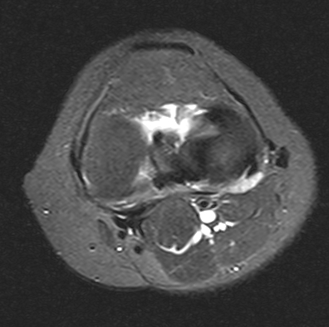
May 2019 (stable since 2016)
Fat sat T2
Pre gad
Post gad

Slide 17
Diagnosis?

Slide 18
Adhesive Capsulitis Mimicking Metastasis on 18F-FDG-PET/CT - Salem; Zhang; Jorgensen; Kumar; Behrang Amini
The acetabular fossa hot spot on ¹⁸ F-FDG PET/CT: epidemiology, natural history, and proposed etiology - Kubicki, Michael Richardson, Thomas Martin, Rohren, Wei, Behrang Amini

Slide 19
77 year old man SCC right tonsil initial dx Nov 2018 T3N0M0
4/30/2019 SUV 11.2 previous 8.8 (11/9/2018)

Slide 20
61 year old woman with SCC initial diagnosis Nov 2017 T4N3M0

Slide 21
32 year old man with HIV and diffuse adenopathy, concern for malignancy

Slide 22
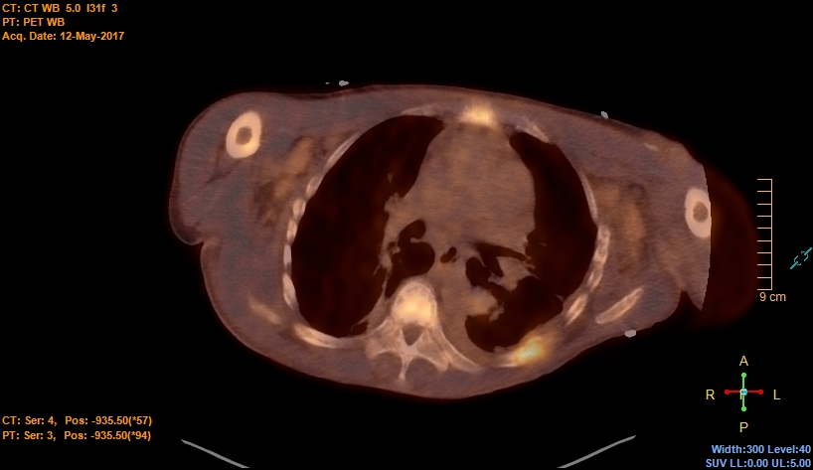
“Hot” on PET/CT – SUV 5

Slide 24
Brown tumor of ESRD

Slide 25
Brown tumor pathology
Vascular lesion
Red-brown color from hemorrhage/hemosiderin

Slide 26
35 year old man hospitalized for dyspnea, pain after a fall

Slide 30
Diagnosis?

Slide 31
Diagnosis
Mets, myeloma, lymphoma?
Osteoporosis?
Renal osteodystrophy?
Osteitis fibrosa cystica?
Something else?
Uncontrolled tertiary hyperparathyroidism

Slide 32
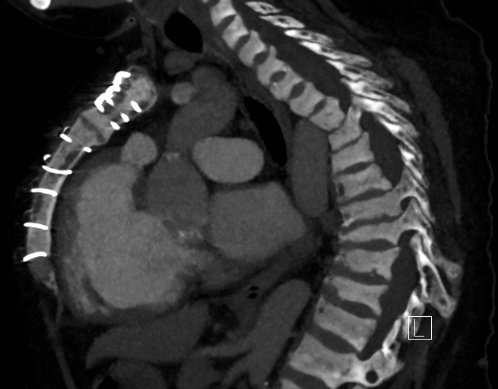
Diagnosis?
Renal osteodystrophy? – partially, he has ESRD from glomerulonephritis

Slide 33
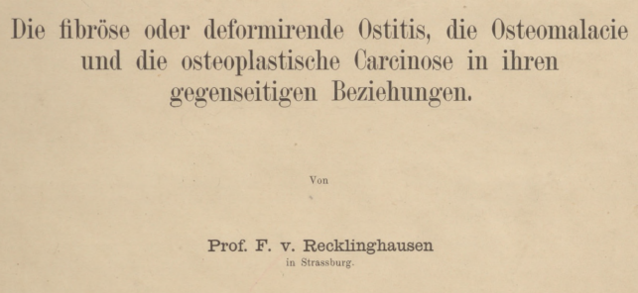
Diagnosis
Renal osteodystrophy?
Osteitis fibrosa cystica? – described 1891, only later (1904) associated with primary hyperparathyroidism

Slide 34
Pathology Fibrous tissue, cystic spaces, brown tumors

Slide 36
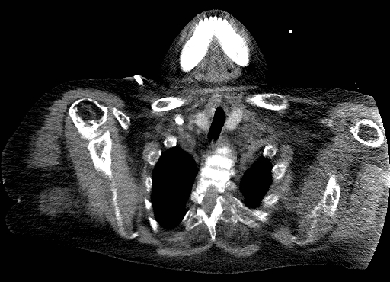
Diagnosis
Something else - Uncontrolled tertiary hyperparathyroidism, PTH >4000 (nl 8-54)

Slide 37
Hyperparathyroidism
Primary – parathyroid adenoma, bone path “a porotic bone with enlarged vascular spaces which have been refilled with a white or gray connective [fibrous] tissue … no excessively wide osteoid seams”
Secondary – chronic renal disease leads to combo of osteomalacia and HPT bone disease, bone path “widespread prominent osteoid seams”
Tertiary – autonomous parathyroids
Milgram J. Radiologic and histologic pathology
of nontumorous diseases of bones and joints

Slide 38
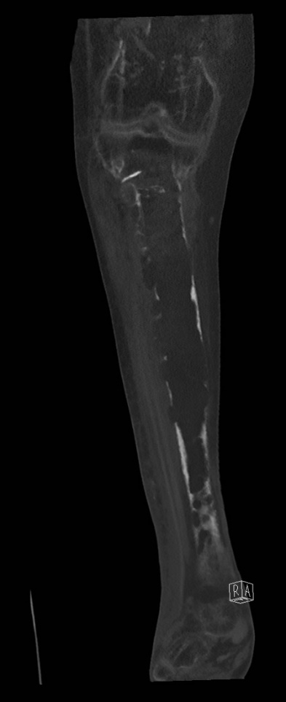
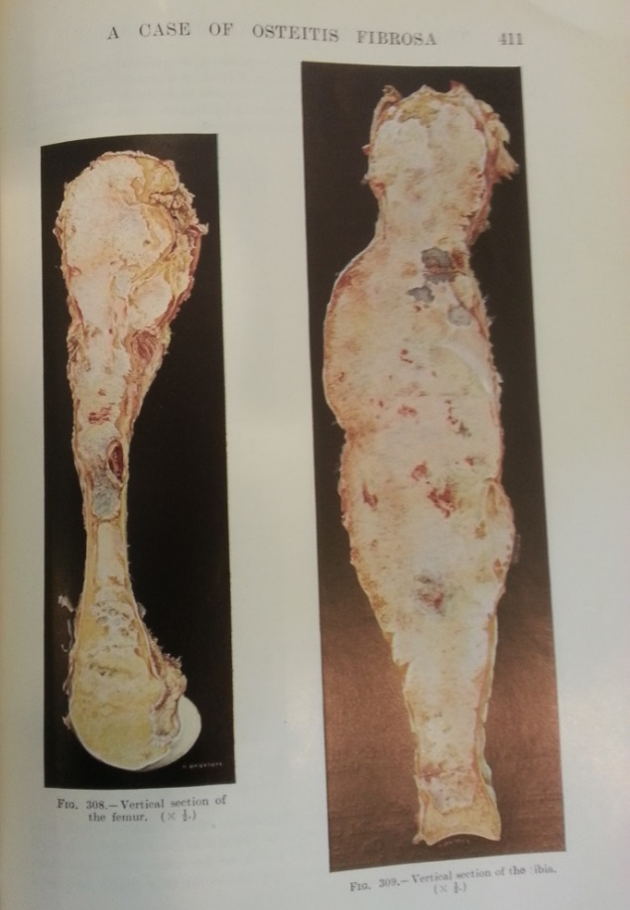
Final Rad/Path Diagnosis
OMG! (osteoclastosis maxilipomatosis generalisata)

