Slide 1
Professionalism: Lessons from Social Media
Donald J. Flemming, M.D., FACR Department of Radiology
Penn State Hershey Medical Center

Slide 2
Objectives
Describe challenges of professionalism in digital world
Describe teaching and assessment of professionalism
Describe role of ABR, ACGME and PD in professionalism

Slide 3
ACGME Mission Statement
We improve health care and population health by assessing and advancing the quality of resident physicians' education through accreditation.

Slide 4
ABR Mission Statement
Our mission is to certify that our diplomates demonstrate the requisite knowledge, skill, and understanding of their disciplines to the benefit of patients.

Slide 5
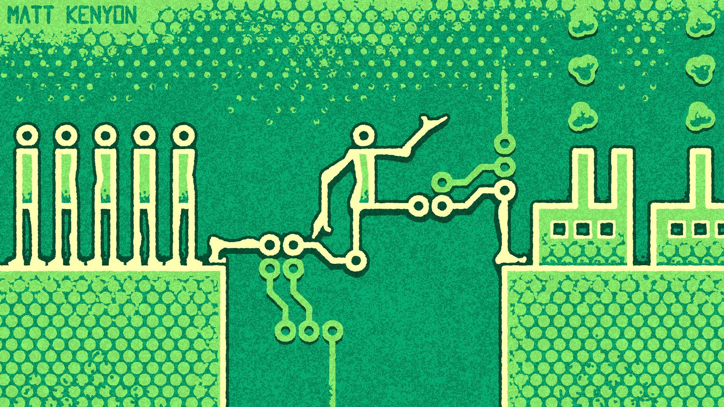
ACGME
PD
ABR

Slide 6
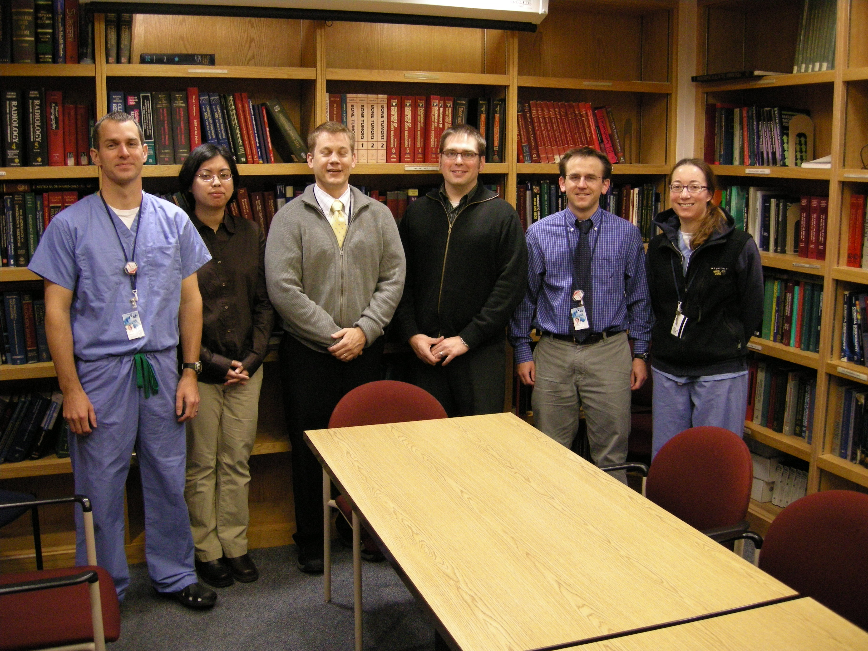
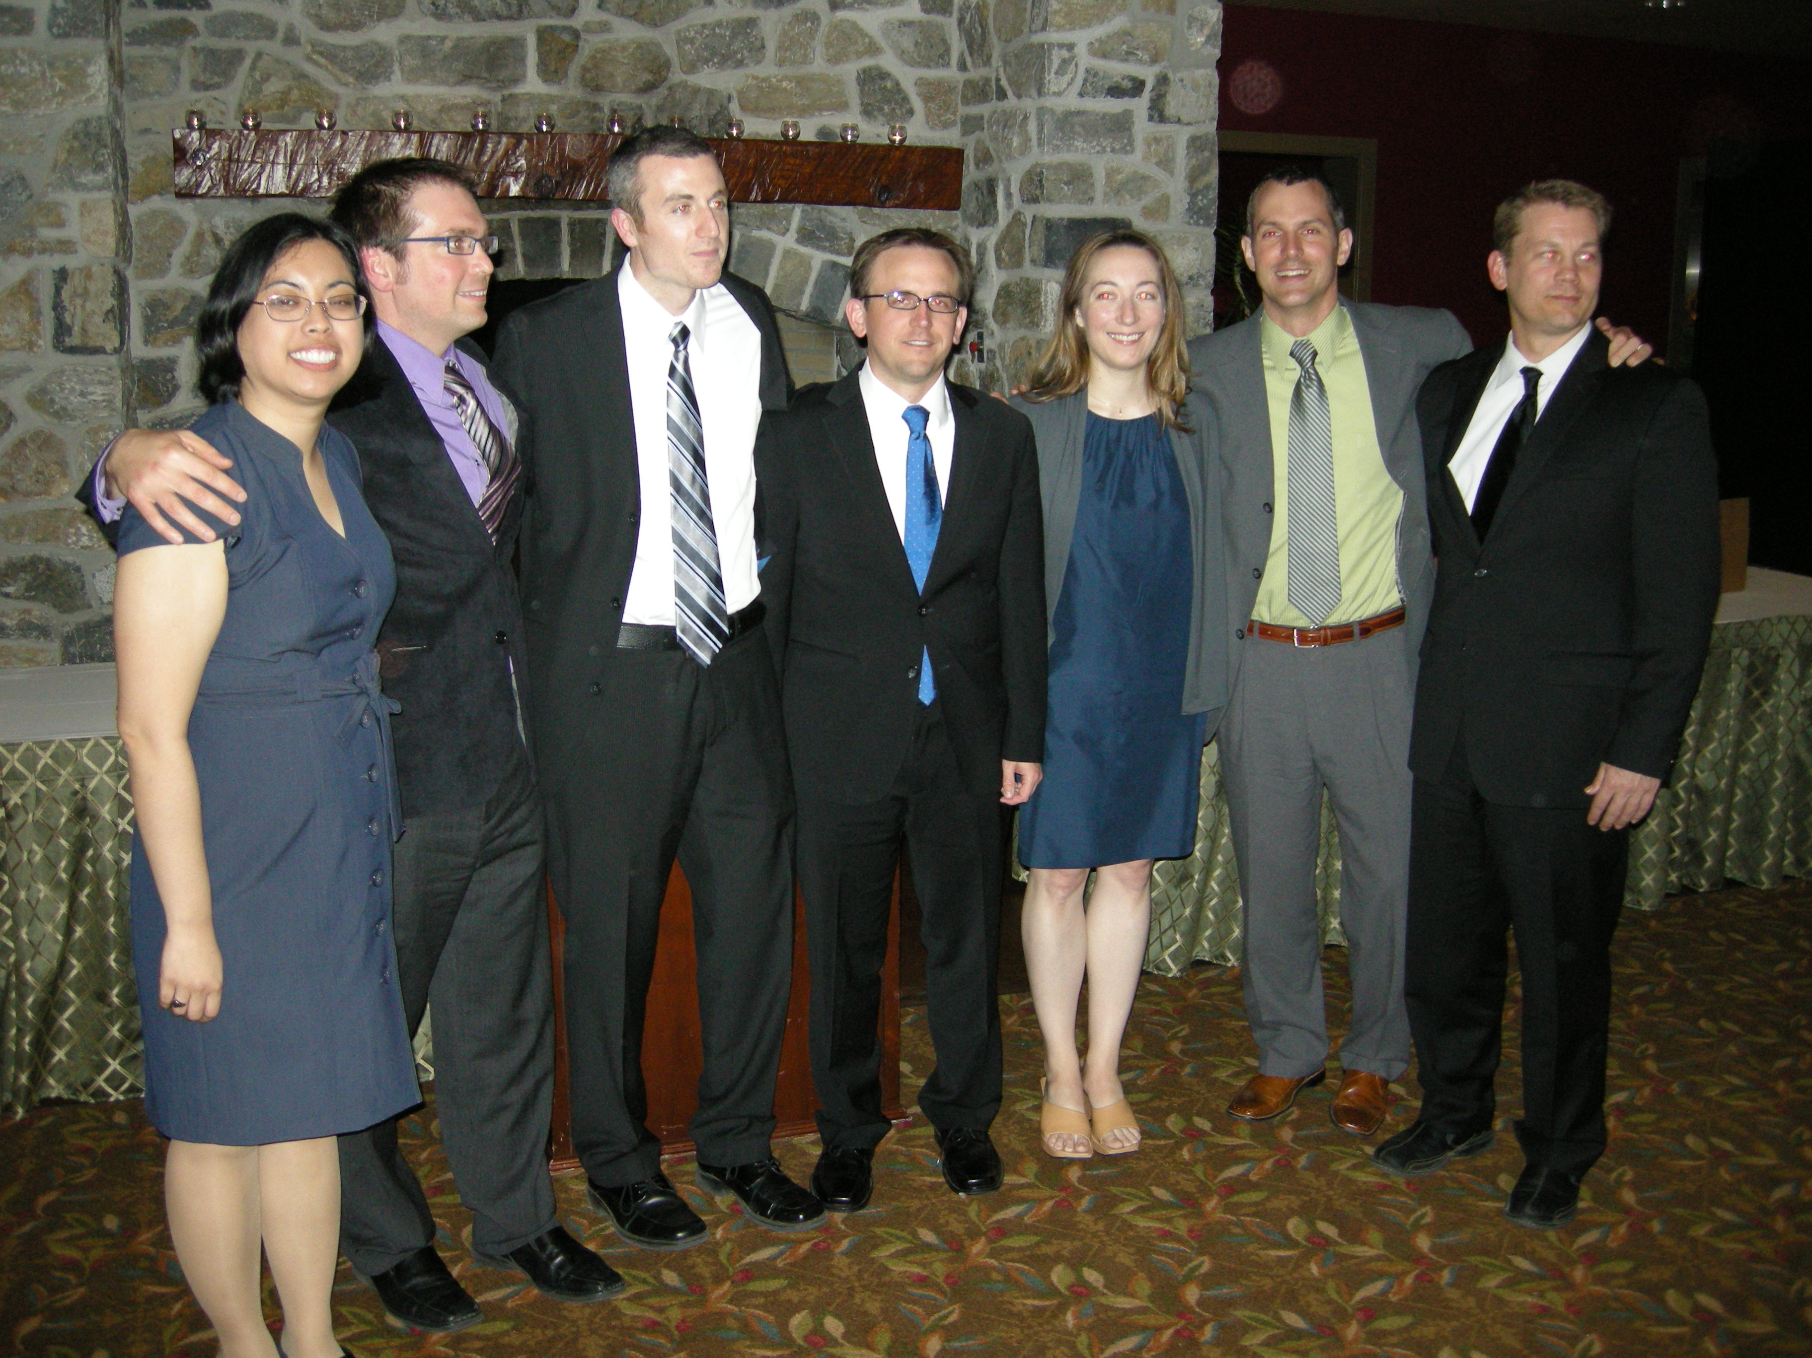
2007
2011

Slide 7
What could go wrong?
Sex
Substance abuse
Money

Slide 8
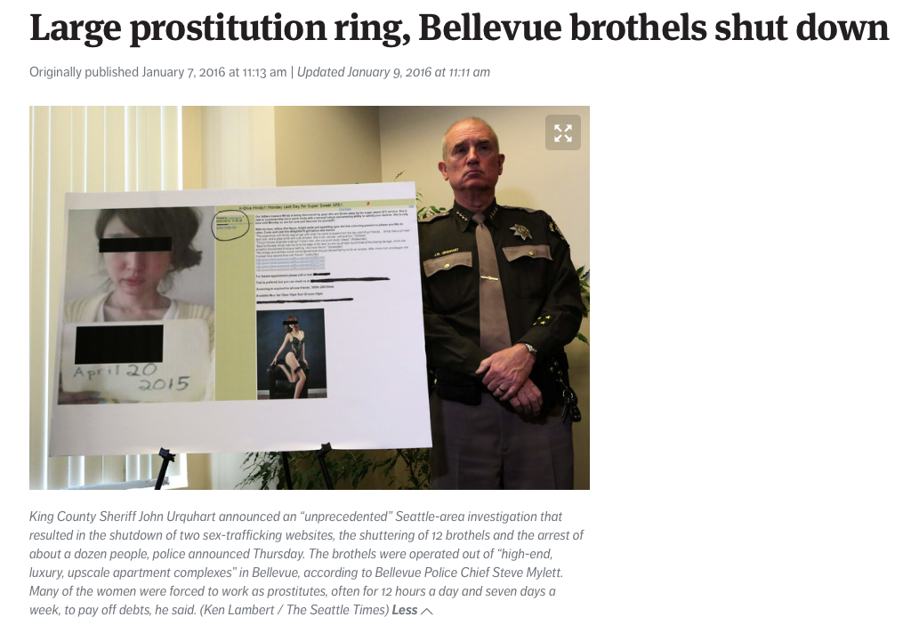
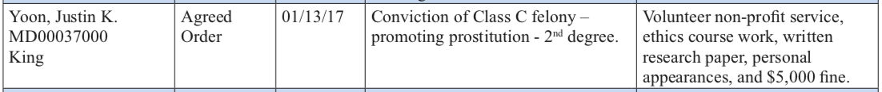
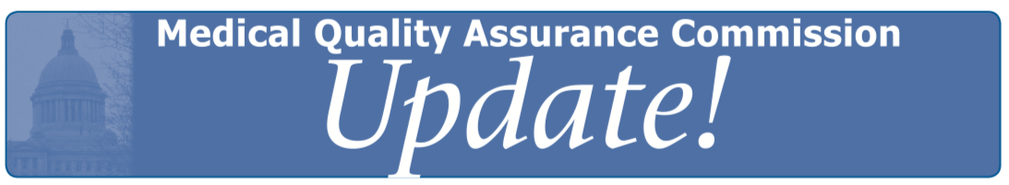
https://www.seattletimes.com/seattle-news/crime/online-site-where-men-rated-prostitutes-is-shut-down-charges-to-be-filed/

Slide 9
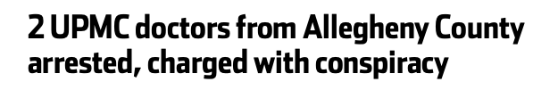
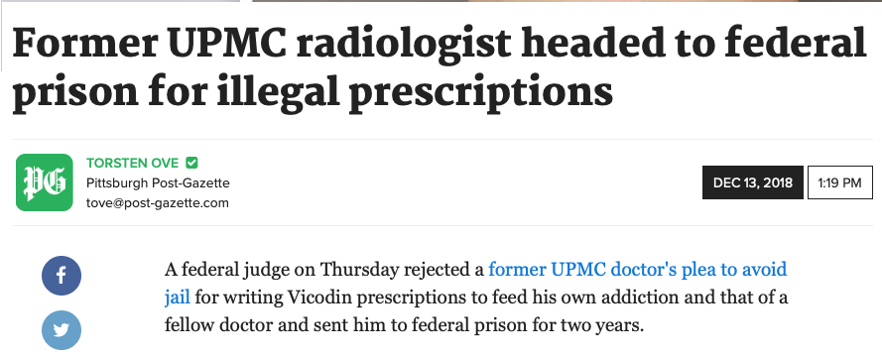
https://archive.triblive.com/local/pittsburgh-allegheny/2-upmc-doctors-from-allegheny-county-arrested-charged-with-conspiracy/
https://www.post-gazette.com/news/crime-courts/2018/12/13/UPMC-Pittsburgh-radiologist-Marios-Papachristou-Omar-Almusa-federal-prison-sentence-illegal-prescriptions/stories/201812130136

Slide 10
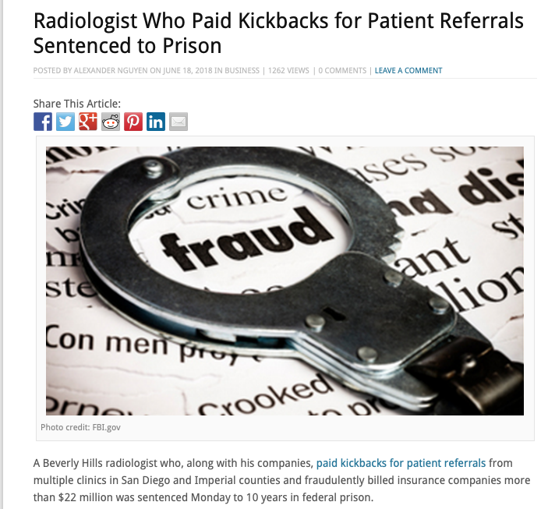
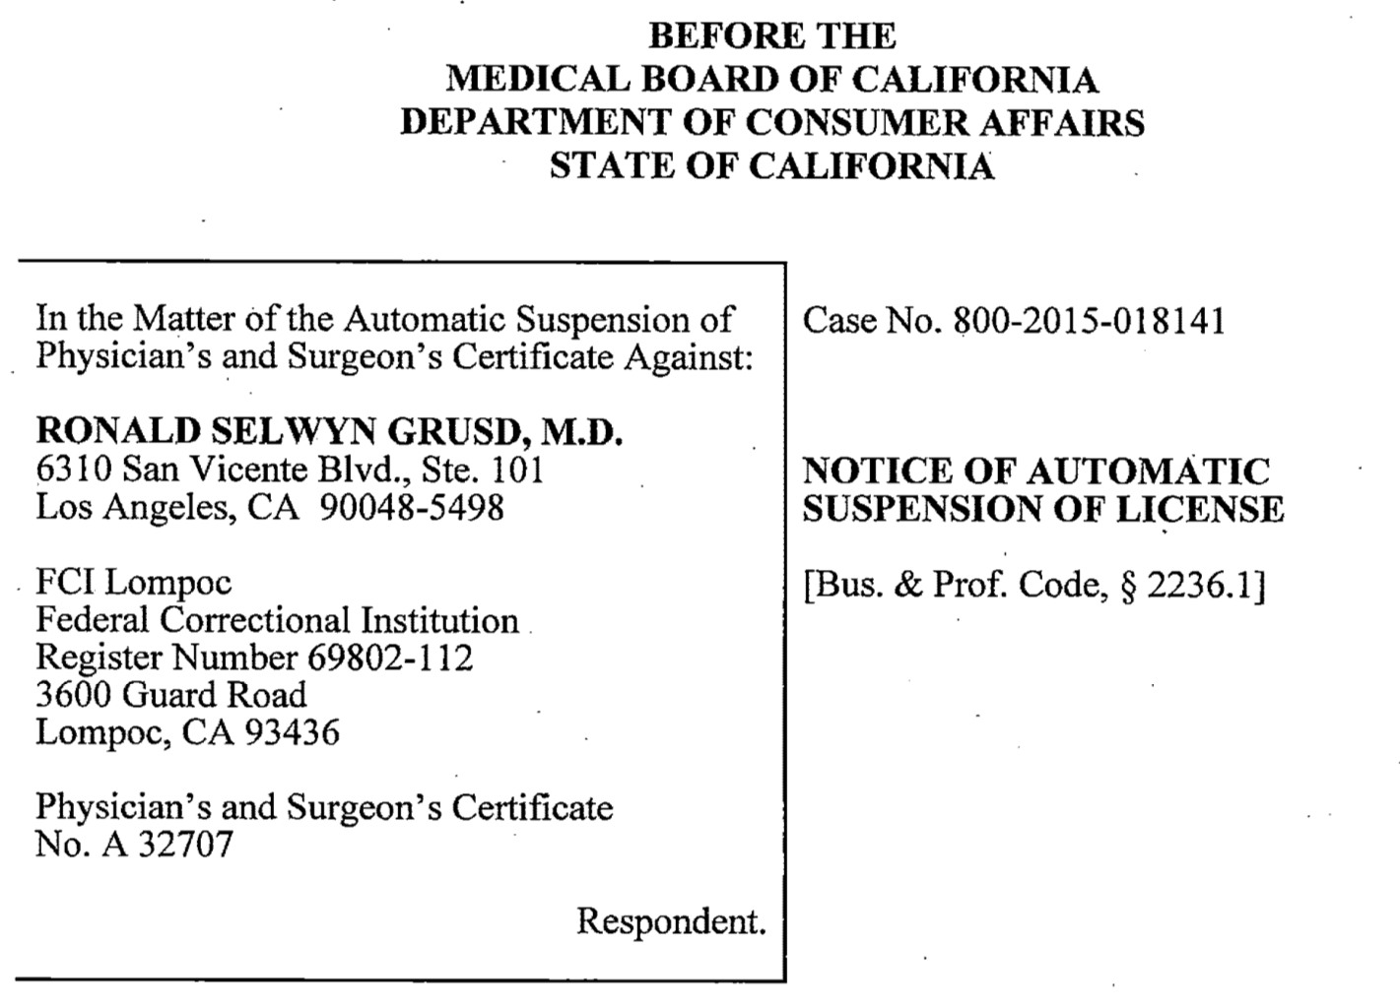
https://timesofsandiego.com/business/2018/06/18/radiologist-who-paid-kickbacks-for-patient-referrals-sentenced-to-prison/
http://4patientsafety.org/mdb/showdr.php?mainID=804

Slide 11
ACR Radiology 3.0?

Slide 12
Digital World - Opportunity
PACS/EMR
Voice recognition
3D Imaging
Digital Library
Online assessment
Telemedicine
Online CME
Webinar
Podcast
Blog/Vlog
Online community
Artificial intelligence

Slide 13
Digital World - Risk
PACS/EMR
  HIPPA
  Cut and paste
  Consult wars
Plagiarism
  Plagiarism checker
Copyright infringement
Inappropriate internet searches
Stolen software/content
Streaming access hacks
Inappropriate use of social media
  Licensure
  Board certification
Health effects/well-being
  Sleep deprivation
  Cyber bullying
  Suicide

Slide 14
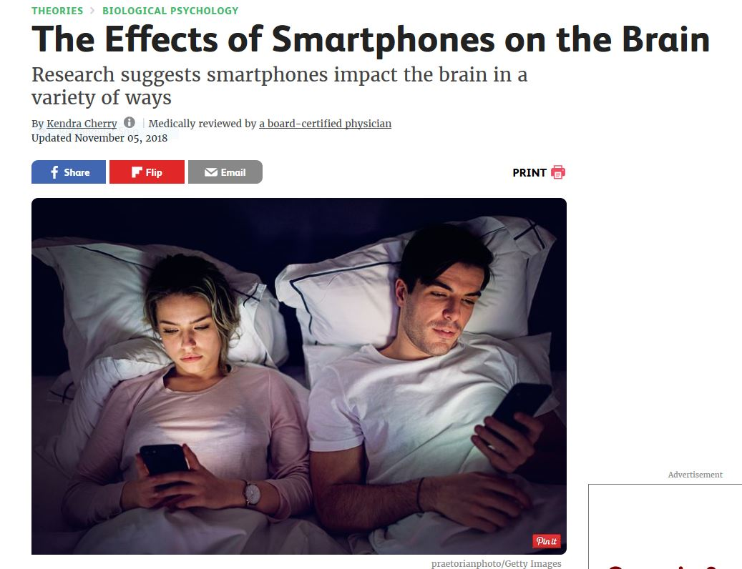
https://www.verywellmind.com/how-do-smartphones-affect-the-brain-2794892

Slide 15
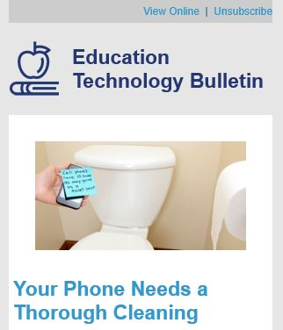
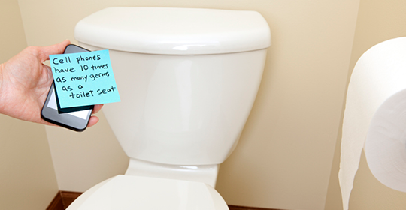
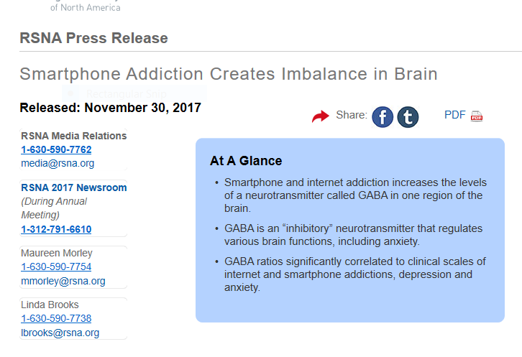

Slide 16



Slide 17
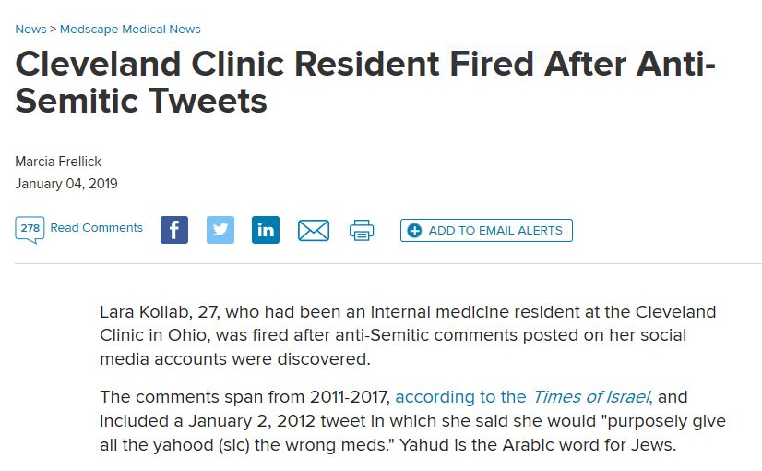
2007
2011

Slide 18
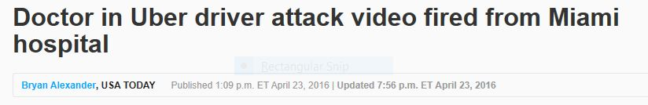
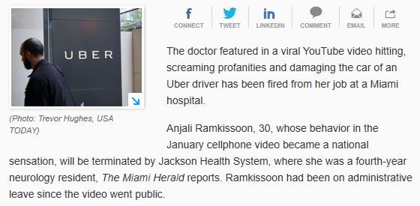

Slide 19
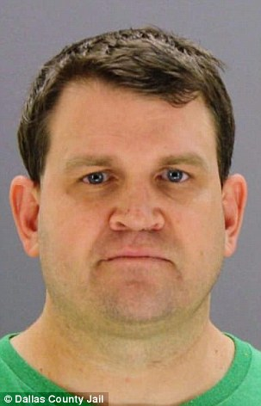
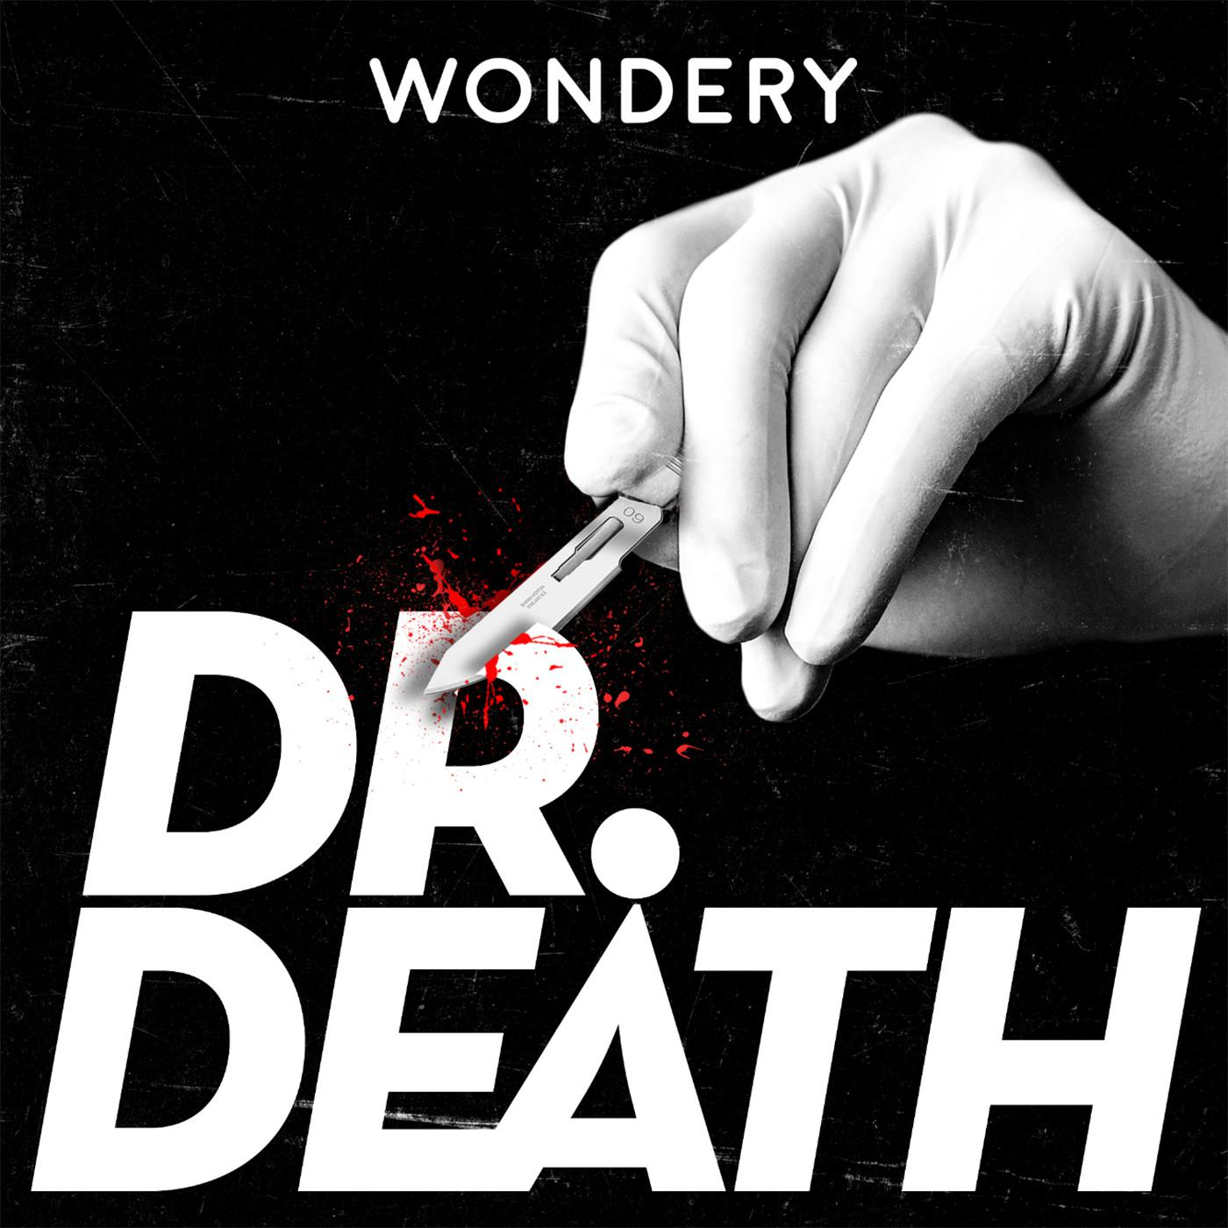

Slide 20
Christopher Duntsch, MD, PhD
U. Tenn Neurosurgery
Research Dallas, Tx
33 patients
  2 deaths
  Paralyzed childhood friend
Substance abuse
Criminally prosecuted
  Life sentence
  Aggravated assault

Slide 21
Professionalism
Do we need to teach it?
Do we need to assess it?

Slide 22
Professionalism
Virtues Model
Behavioral Model
Identity Formation Model

Slide 23
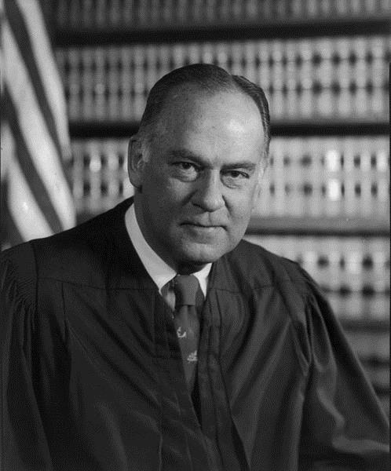
Professionalism
I know it when I see it
Potter Stewart
Jacobellis v. Ohio
1964

Slide 24
Professionalism
Virtues Model - Character
  Altruism, humility, integrity, caring, compassionate, respectful
  Role models, case studies, reflective practice
  Difficult to assess

Slide 25
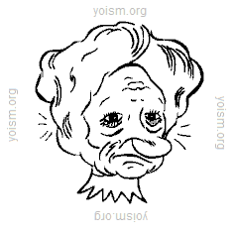

Slide 26
What would you do?
You are presented with video evidence of your resident stealing food from the cafeteria on multiple occasions by walking out entrance after getting food in hot line. He has money on his food card. He states that he did not have time to wait in line to pay for food because he needed to get back to the OR.
Coffee conversation
Letter of reprimand
Probation
Termination

Slide 27
Professionalism
Behavioral Model
  Performance over character; skill to be learned; competency
  Incorporates health care teams; systems approach
  Coaching and direct interventions
  Defined in detail and therefore reductionist

Slide 28
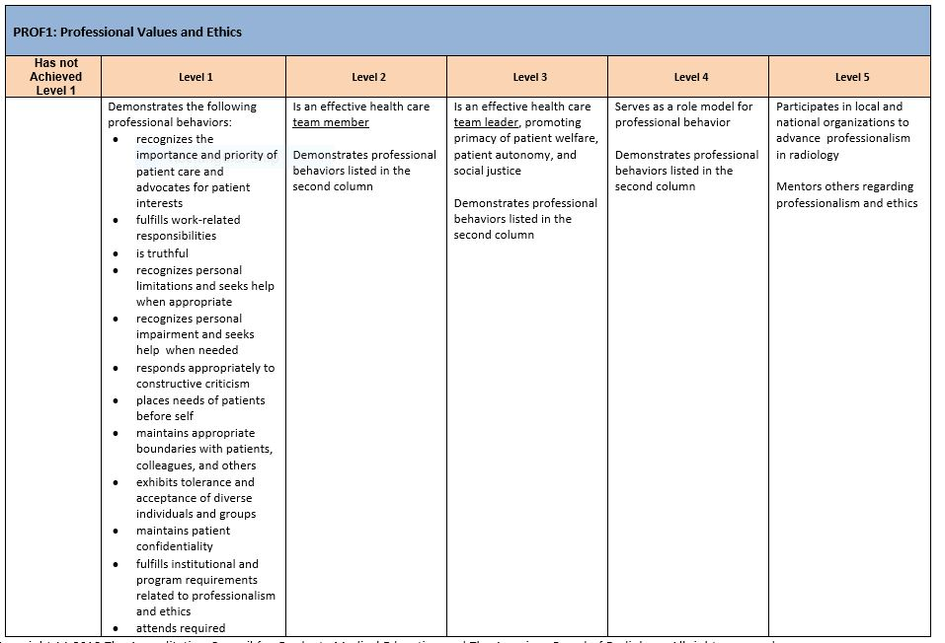

Slide 29
Professionalism
Identity Formation Model
  Adaptive developmental process
  Values, habits and behaviors of a community
  Aspirational
  Role models and reflective practice
  Definition of identity?

Slide 30
Do We Need to Teach Professionalism?
World is evolving/changing quickly
  Electronic /Social media
  Racism
  Religion
  LGBT and Gender Identification
  Cultural competency
  Obesity
  Aging population and Ageism
  Profound generational differences
Respect your elders. They graduated from school without the internet

Slide 31
Do We Need to Teach Professionalism?
(JMIR Med Educ 2017;3(1):e2)

Slide 32
Investigating offense -
40% of state medical boards¹
Violation of FSMB Guidelines²
Ann Intern Med 2013 Jan 15;158(2):124-130
https://www.fsmb.org/siteassets/advocacy/policies/model-guidelines-for-the-appropriate-use-of-social-media-and-social-networking.pdf
(JMIR Med Educ 2017;3(1):e2)

Slide 33
FSMB Sanctions and Disciplinary Findings
Inappropriate communication with patients online
Use of the Internet for unprofessional behavior
Online misrepresentation of credentials
Online violations of patient confidentiality
Failure to reveal conflicts of interest online
Online derogatory remarks regarding a patient
Online depiction of intoxication
Discriminatory language or practices online
https://www.fsmb.org/siteassets/advocacy/policies/model-guidelines-for-the-appropriate-use-of-social-media-and-social-networking.pdf

Slide 34
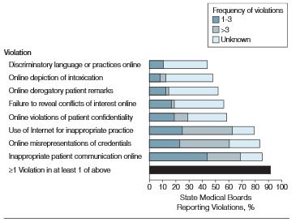
SMB Actions – Online Professionalism
Inappropriate patient communication
  Sexual misconduct
Use of internet for inappropriate practice
  Prescribing without clinical relationship
Online misrepresentation of credentials
Outcomes
  Restriction, suspension or revocation – 56%
  Letter of reprimand – 23%
JAMA. 2012 Mar 21;307(11):1141-2

Slide 35
Do We Need to Teach Professionalism?
Emergency physicians (residents/faculty) and SMB’s¹
  Aligned
    Patient information, inappropriate communication, and discriminatory speech
  Not aligned
    Derogatory remarks, alcohol use
Urologists²
  Facebook - residency graduates
    40% unprofessional content
    13 % explicitly unprofessional
      Intoxication, uncensored profanity, unlawful behavior, confidential patient information
J Grad Med Educ. 2017 Feb;9(1):85-89
BJU Int. 2017 Jun;119(6):955-960.

Slide 36
Do We Need to Teach Professionalism?
Dangers of Social Media¹
  Audience is poorly defined
  Accuracy is not guaranteed
  Nothing is truly private
  Fairness is seemingly irrelevant
  Nothing is temporary and the past can haunt you
Teaching may change behavior²
1) Clin Colon Rectal Surg. 2017;30:264-269
2) J Med Internet Res. 2016 Jun 9;18(6):e119

Slide 37
Do We Need to Teach Professionalism?
Acknowledge the positives of social media
Need to guide rather than proscribe?
New definition of professionalism?
Reasonable approach¹
  Practice - deliberate, ethical, accountable
  Strategies - awareness, alignment, assessment, accountability
1) Med Teacher 2015, 37: 844–849

Slide 38
Do We Need To Assess Professionalism?
Awareness and correction
ACGME requirement

Slide 39
Do We Need To Assess Professionalism?
Awareness and correction
ACGME requirement
Barriers*
  Uncertainty about process
  Ambiguity about facts
  Effects on the learner
  Time constraints
  Fear of retribution
  Responsibility about reporting
* Acad Med. 2018;93:1700–1706.

Slide 40
Do We Need To Assess Professionalism?
  Medical students with professionalism issues¹
    Irresponsible ≥3 events – 8x more likely to disciplined by SMB
    Resistant to self improvement – 3x more likely
  Int Med – behavioral and cognitive issues at risk for SMB action²
    Low professionalism score on annual assessment increased risk
    High ABIM cert exam scores decreased risk
  Public judgment can be harsher than peers or faculty³
N Engl J Med 2005;353:2673-82
Ann Intern Med. 2008; 148(11):869-76
Med Teach. 2011;33(9):e501-8

Slide 41
Recommendations
Consider developing or reviewing social media policy
Do not assume that role modeling is enough
Include reflective practice and case study discussion in teaching
Have residents/faculty review their social media foot print
Foster culture of professionalism with consistent approach
Develop roadmap for management of professionalism lapses

