Slide 1
MSK US as a Problem Solving Tool
Daria Motamedi, MD
Associate Professor of Clinical Radiology
Musculoskeletal Imaging Section
UCSF Medical Center

Slide 2
Objectives
Utility of MSK US as a problem-solving tool
Representative case-based imaging review

Slide 3
MSK US as a Problem Solver
Postoperative
Hardware cx
Color/Power Doppler
Directional blood flow
Fine Detail
Articular cartilage
Targeted
Friction syndromes

Slide 4
MSK US as a Problem Solver
Postoperative
Hardware cx
Color/Power Doppler
Directional blood flow
Fine Detail
Articular cartilage
Targeted
Friction syndromes

Slide 5
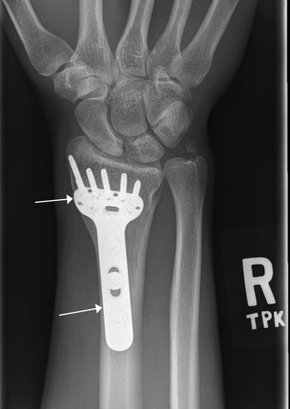
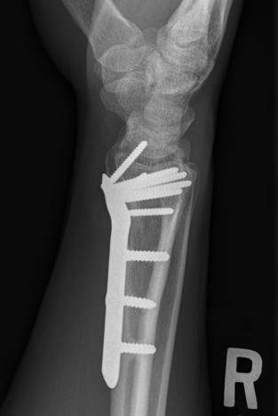
Case 1
Frontal and lateral radiographs obtained for continued postoperative wrist pain.

Slide 6
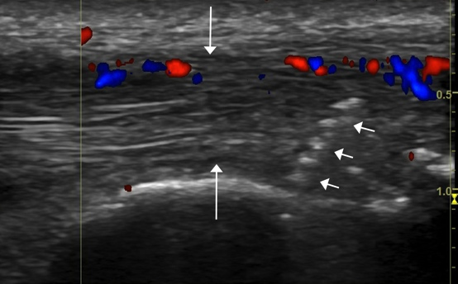
Case 1
Longitudinal US w/ color Doppler reveals protrusion of screw beyond dorsal radial cortex and market enlargement and hypervascularity of the EPL tendon.

Slide 7
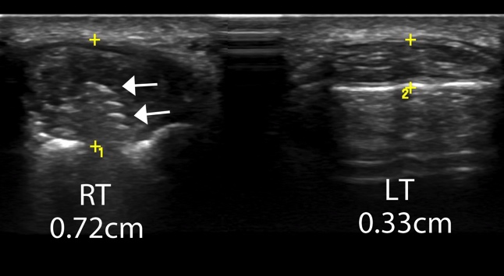
Case 1
Transverse grey scale US shows asymmetric marked enlargement of the right EPL tendon compared with the left.

Slide 8
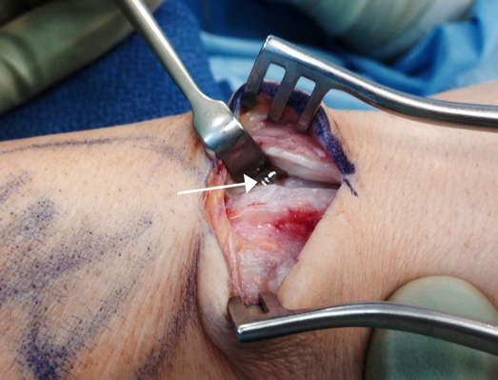
Case 1
Intra-operative evaluation confirms proud dorsal screw.

Slide 9
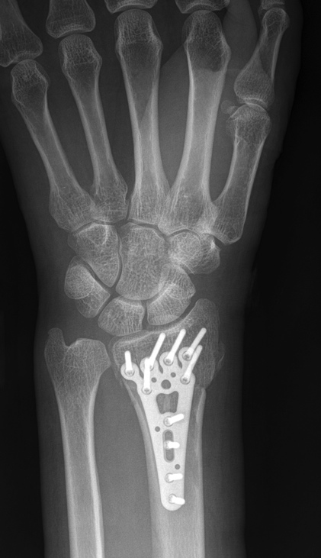
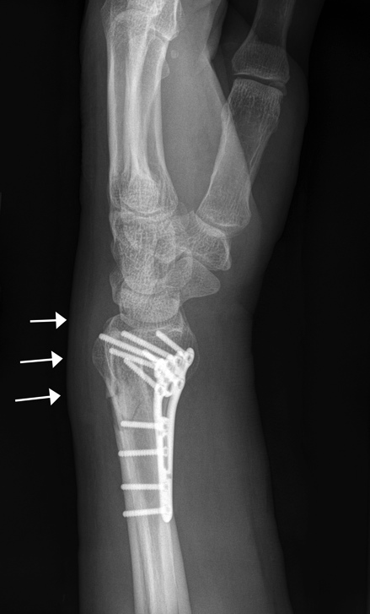
Case 2
Frontal and lateral radiographs again for continued postoperative pain reveals dorsal soft tissue swelling w/o radiographic e/o hardware cx.

Slide 10
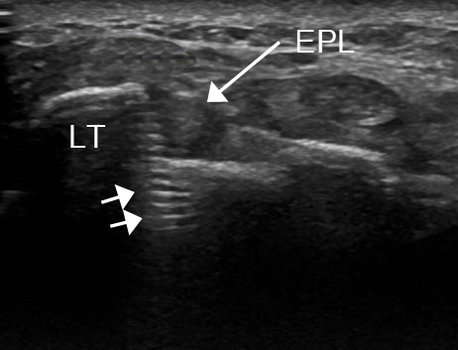
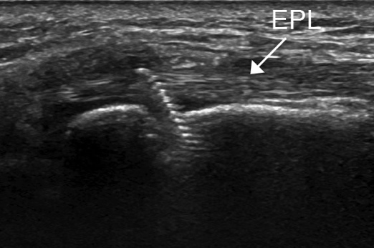
Case 2
Transverse and longitudinal grey scale US demonstrate proud screw just ulnar to Lister’s tubercle.

Slide 11
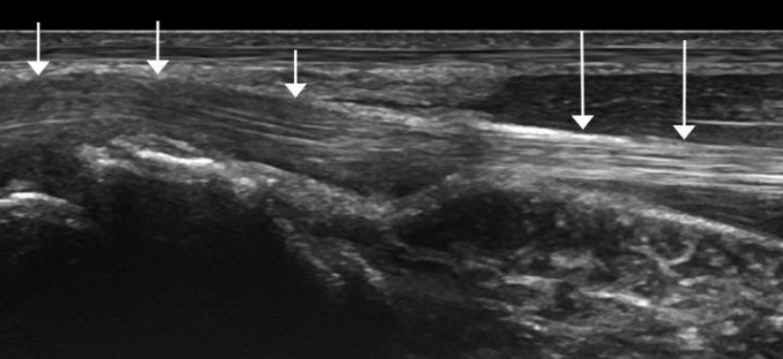
Case 2
Grey scale longitudinal US reveals dorsal displacement of the overlying extensor tendon distally with decreased echogenicity and enlargement of the distal tendon relative to the proximal tendon.

Slide 12
MSK US as a Problem Solver
Postoperative
Hardware cx
Color/Power Doppler
Directional blood flow
Fine Detail
Articular cartilage
Targeted
Friction syndromes

Slide 13
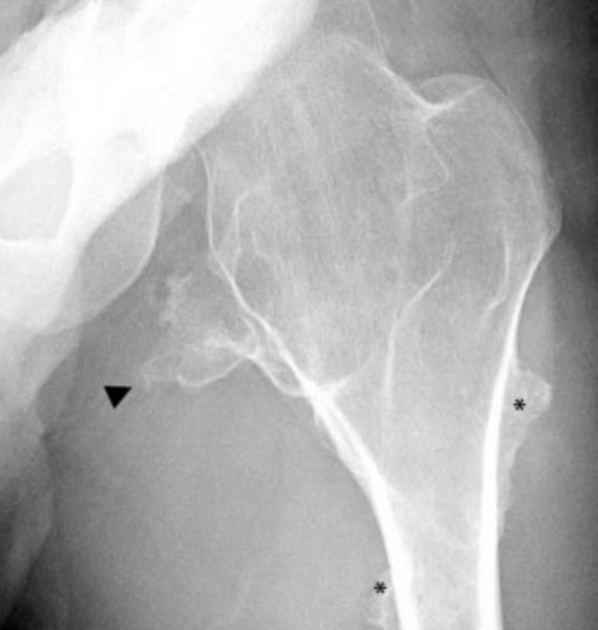
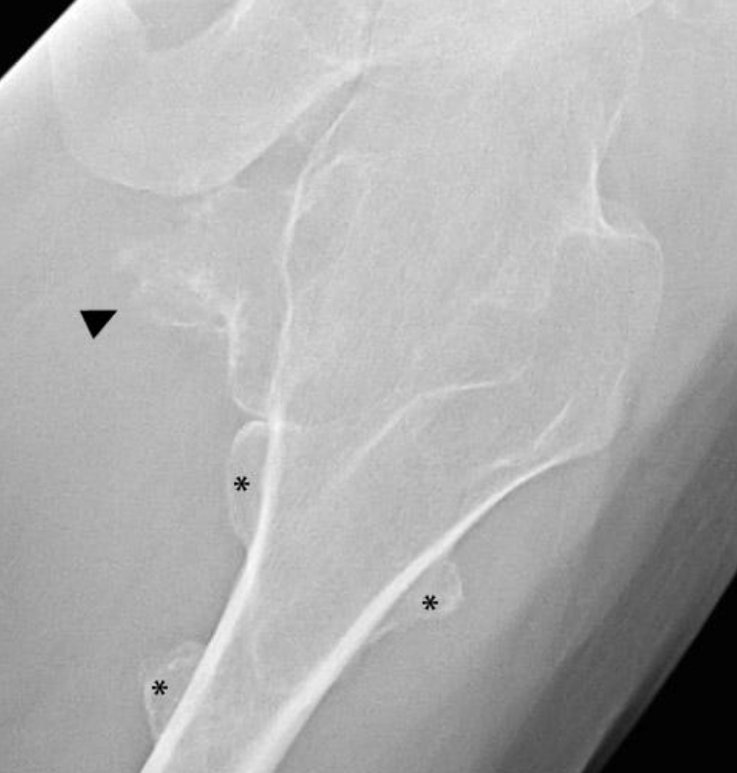
Case 3
28 year old male with MHE and several month history of vague proximal thigh fullness and tightness without radiographic cx.

Slide 14
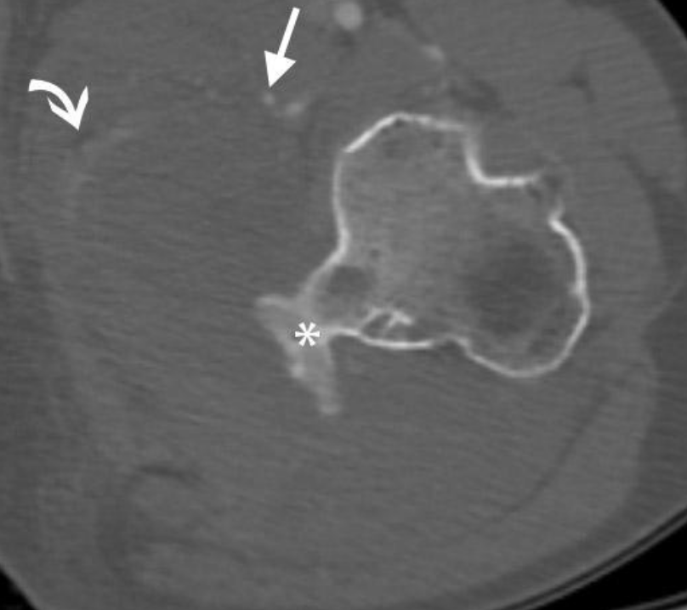
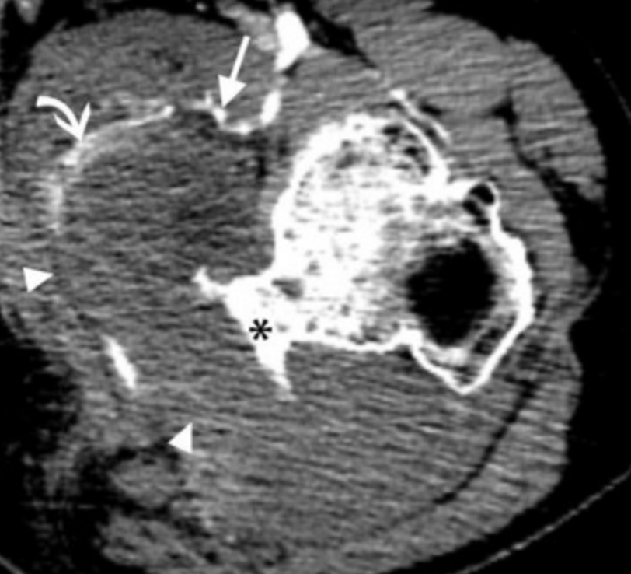
Case 4
CT w/ IVC was obtained for further evaluation and bone and soft tissue windows reveal a non-enhancing soft mass contiguous with lesser trochanter exostosis with the medial femoral circumflex artery displaced and draping over the mass.

Slide 15
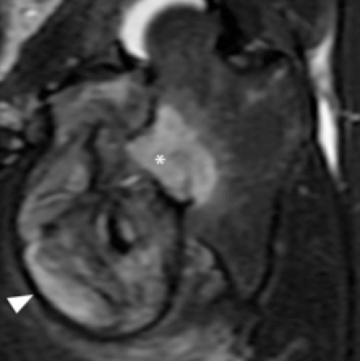
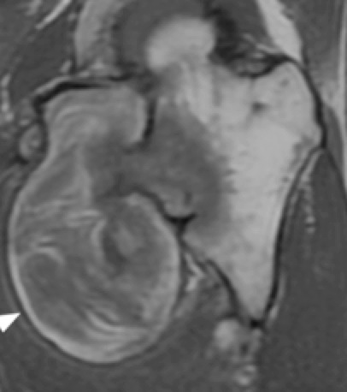
Case 3
Coronal fat and fluid sensitive MRI confirms soft tissue mass intimate with lesser trochanteric exostosis with subjacent marrow edema.

Slide 16
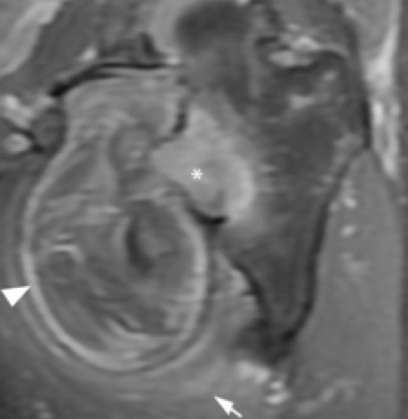
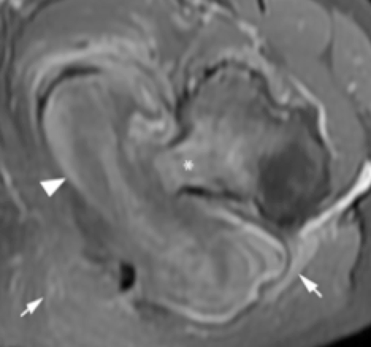
Case 3
Coronal and axial postcontrast MRI demonstrate heterogeneous enhancement predominantly peripherally.

Slide 17
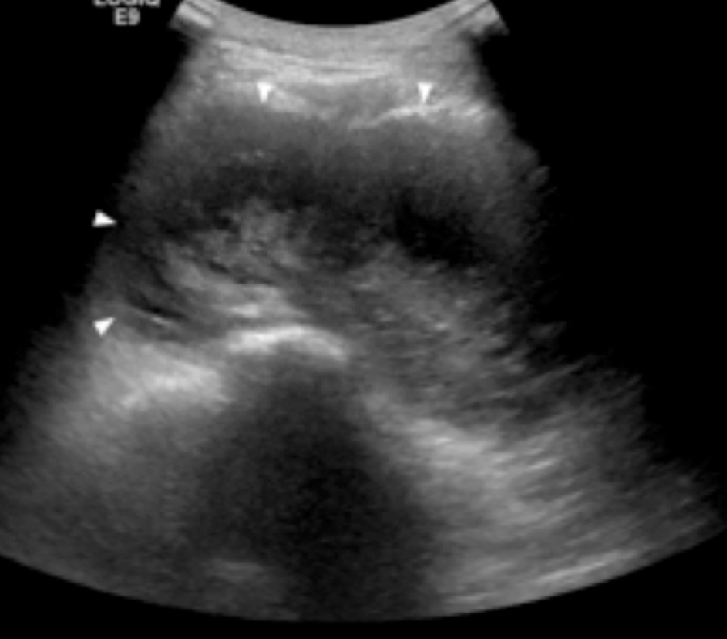
Case 3
Transverse grey scale US re-demonstrates large, heterogeneous, hypoechoic fluid collection.

Slide 18
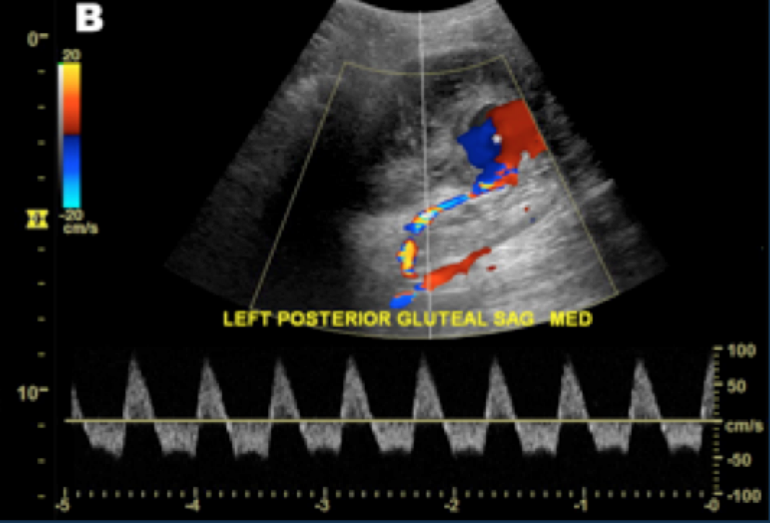
Case 3
Color and spectral Doppler confirms yin-yang and to-and-fro patterns of branch of deep femoral artery pathognomonic of pseudoaneurysm.

Slide 19
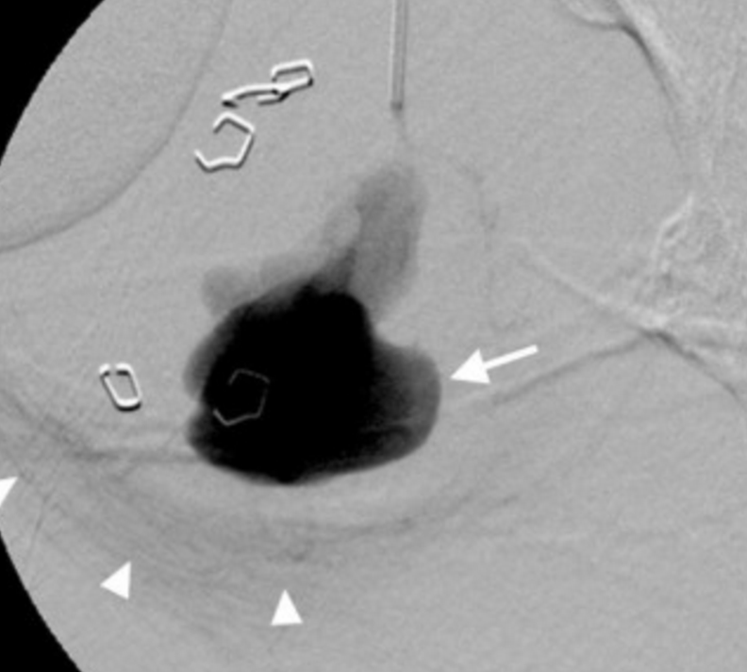
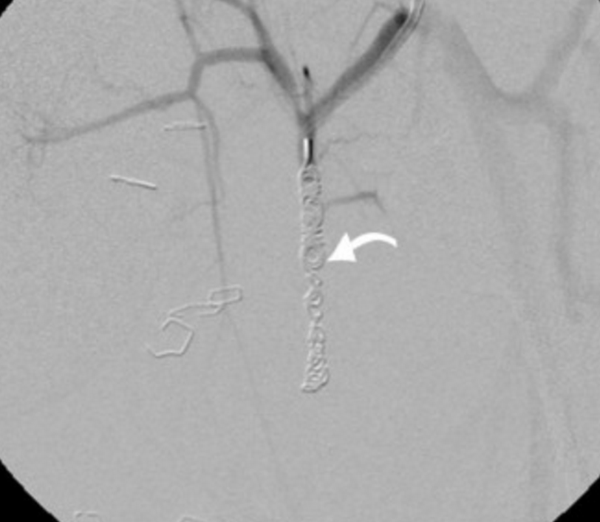
Case 3
Patient underwent coil embolization of the left medial femoral circumflex artery pseudoaneurysm and resection of lesser trochanteric exostosis. Angiogram reveals blush c/w minimal contrast extravasation before successful coiling.

Slide 20
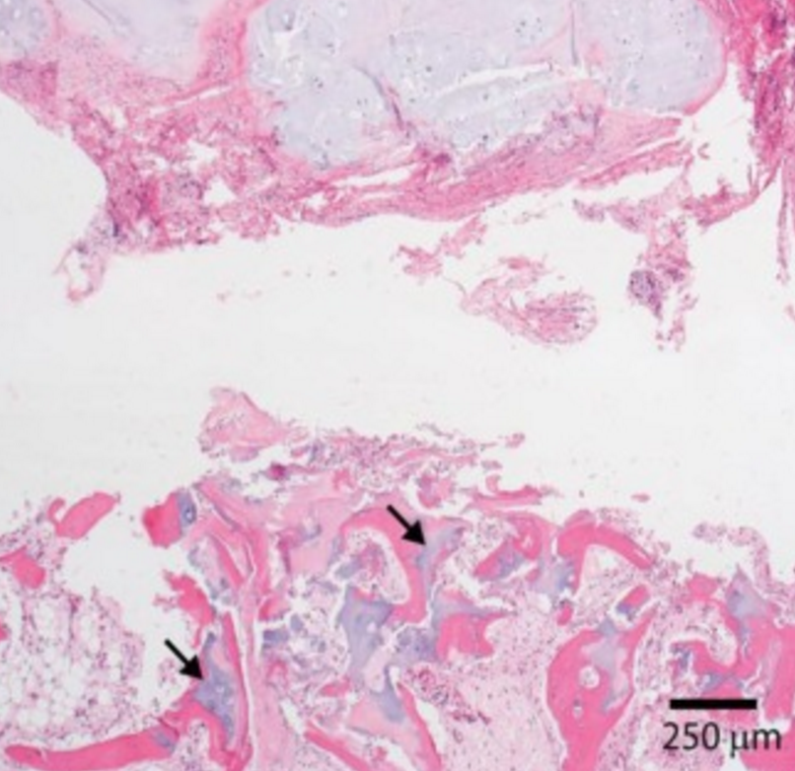
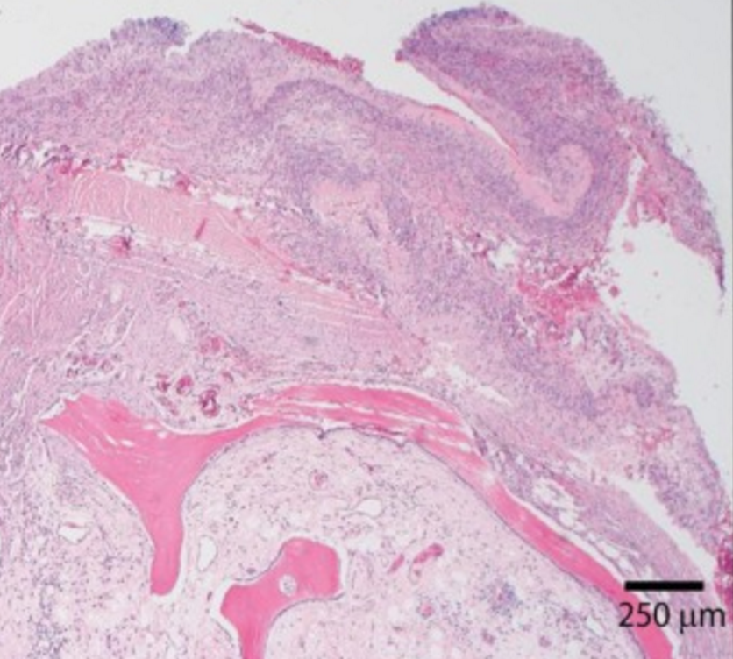
Case 3
Path slides confirm cartilage w/ endochondral ossification in addition to thin fibrin capsule consistent with pseudoaneurysm.

Slide 21
MSK US as a Problem Solver
Postoperative
Hardware cx
Color/Power Doppler
Directional blood flow
Fine Detail
Articular cartilage
Targeted
Friction syndromes

Slide 22
Case 4
Hyperechoic line at the outer surface of hyaline cartilage (MSU crystal deposition) paralleling the articular surface consistent with double contour cartilage line sign in gout.

Slide 23
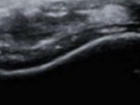
Case 5
In contrast to gout, CPPD crystals aggregate in the middle layer of hyaline articular cartilage and appear as hyperechoic, irregular, dotted foci within the anechoic hyaline cartilage.

Slide 24
Case 4/5
Normal
Gout
CPPD

Slide 25
MSK US as a Problem Solver
Postoperative
Hardware cx
Color/Power Doppler
Directional blood flow
Fine Detail
Articular cartilage
Targeted
Friction syndromes

Slide 26
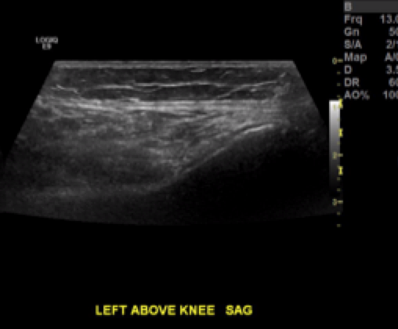
Case 6
52-year-old woman w/ h/o lat knee pain x 3 mo with outside MRI read as normal. Targeted US in region of pain reveals soft tissue stranding and edema interposed between lat fem condyle and ITB.

Slide 27
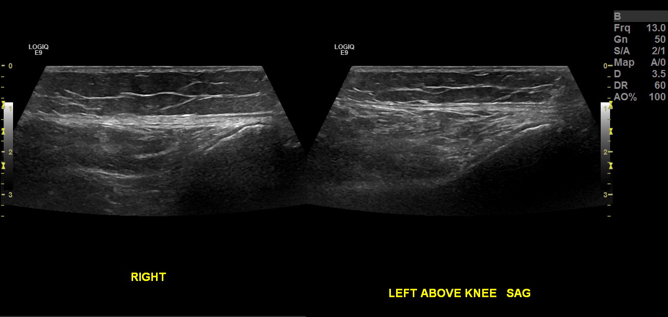
Case 6
Targeted US in L knee reveals increased echogenicity and soft tissue swelling and stranding interposed between lateral femoral condyle and ITB.

Slide 28
Additional Uses
Evaluating for satisfactory fracture reduction
Dynamic imaging (muscle herniation, snapping)
Guiding biopsy, therapeutic interventions

Slide 29
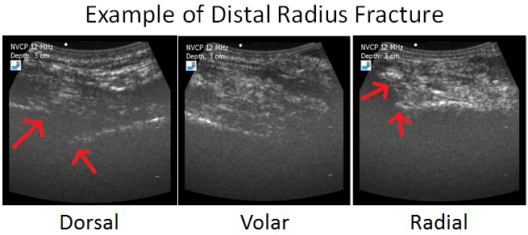
Before Closed Reduction in Field

Slide 30
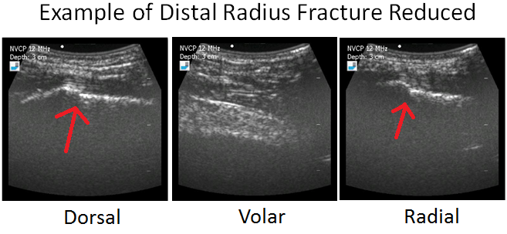
After Closed Reduction in Field

Slide 31
Summary
MSK US is an effective problem solving tool
Advantages include postoperative, color/Doppler, fine detail, and targeted imaging
Simultaneous diagnosis and sampling and/or percutaneous treatment in a single patient visit

Slide 32
Thank You

