Slide 1
MSK Fellowship Match
SABR 2019
Felix S. Chew, MD
University of Washington

Slide 2
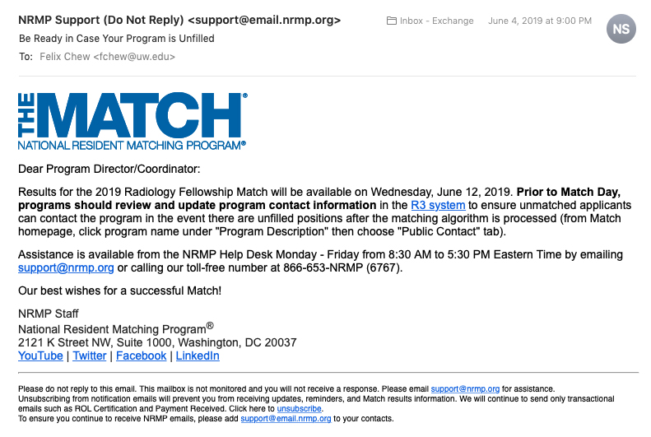

Slide 3
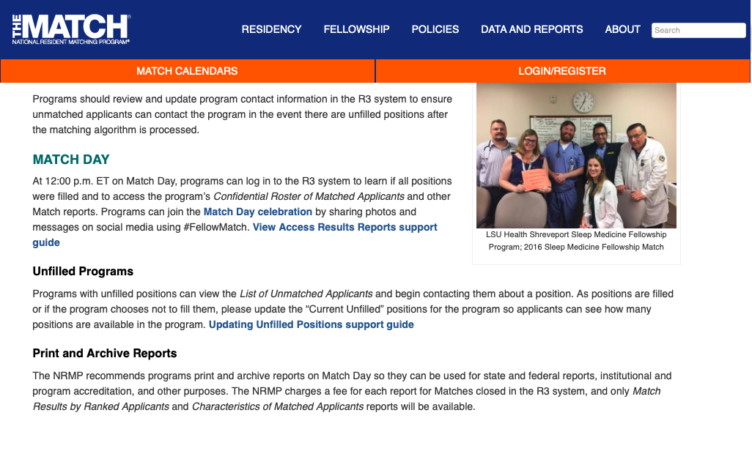

Slide 4
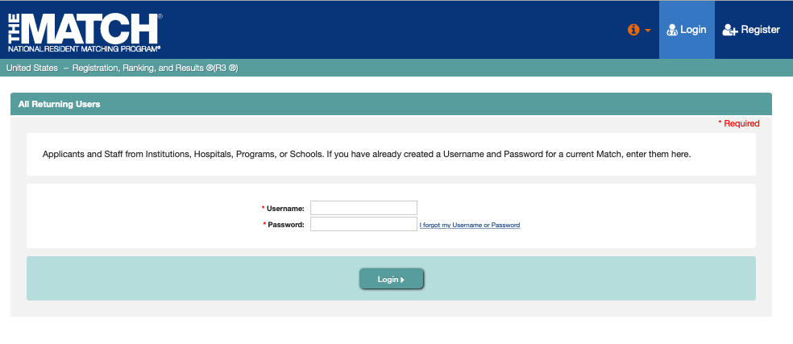

Slide 5
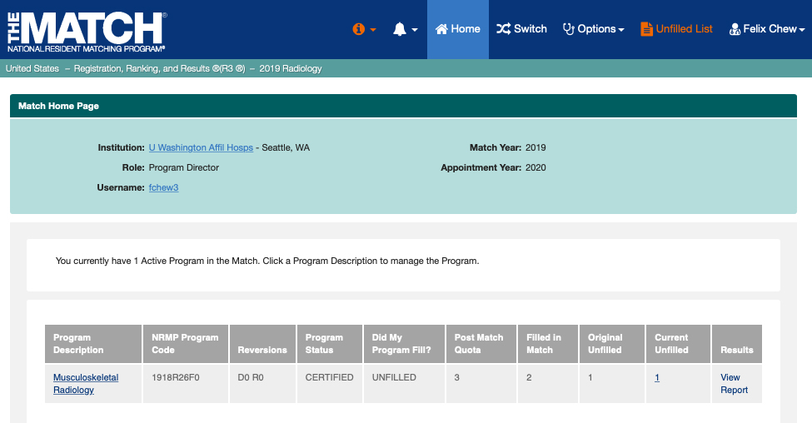
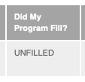

Slide 6
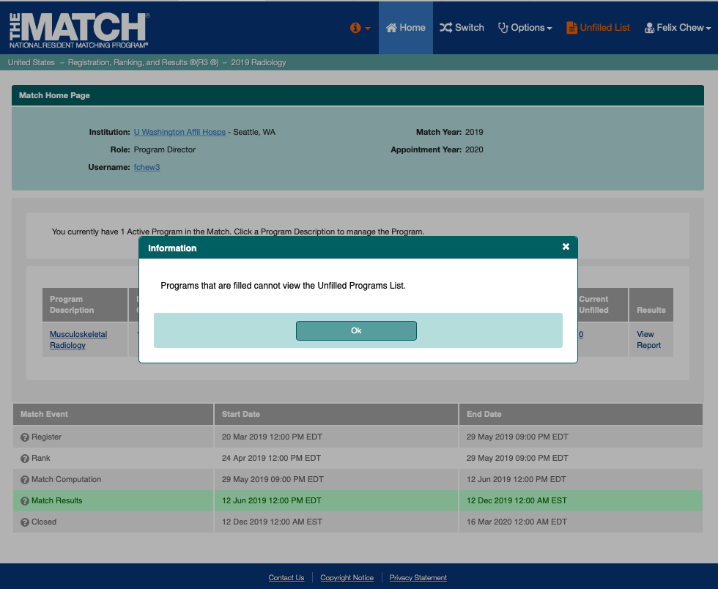

Slide 10
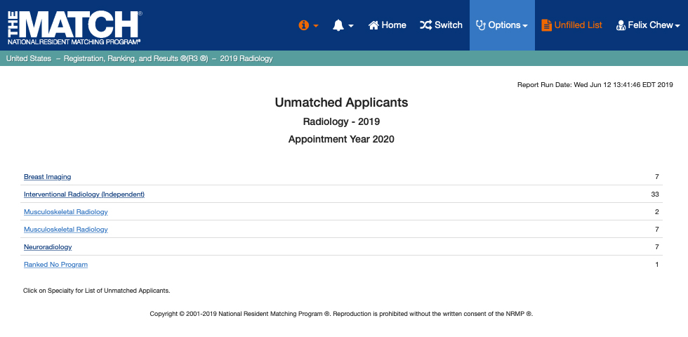

Slide 11
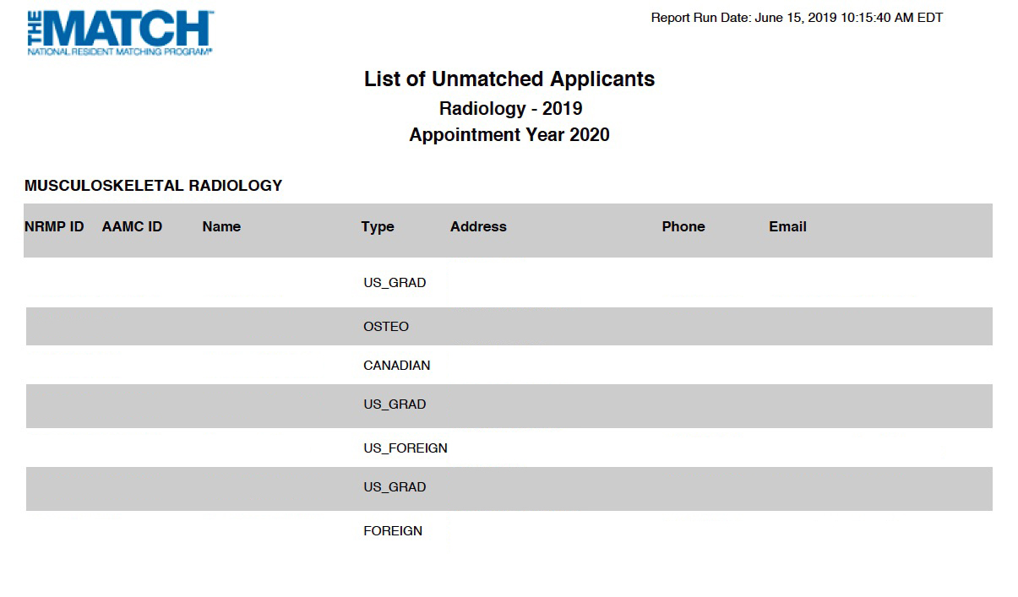

Slide 12
MSK Match Results 2019
Programs
Programs Filled = 57 (70%)
Programs Unfilled = 24 (30%)
Notes:
MSK average program size = 204 / 81 = 2.5
MSK positions per applicant = 204 / 173 = 1.18

Slide 13
MSK Match Results 2019
Programs
Programs Filled = 57 (70%)
Programs Unfilled = 24 (30%)
Positions
Positions Filled = 168 (82%)
Positions Unfilled = 36 (18%)
Notes:
MSK average program size = 204 / 81 = 2.5
MSK positions per applicant = 204 / 173 = 1.18

Slide 14
MSK Match Results 2019
Programs
Programs Filled = 57 (70%)
Programs Unfilled = 24 (30%)
Positions
Positions Filled = 168 (82%)
Positions Unfilled = 36 (18%)
Applicants
Applicants Matched = 168 (97%)
Applicants Not Matched = 5 (3%)
Notes:
MSK average program size = 204 / 81 = 2.5
MSK positions per applicant = 204 / 173 = 1.18

Slide 15
MSK Match Results 2019
NRMP stats
Average program size
204 / 81 = 2.5
Positions per applicant
204 / 173 = 1.18
Notes:
MSK average program size = 204 / 81 = 2.5
MSK positions per applicant = 204 / 173 = 1.18

Slide 16
MSK Fellowship Director Surveys
2015 fall
82 Programs
8 programs did not have fellows
180 positions advertised
190 current fellows
79% men; 21% women
2019 spring
? internal applicants / program
? interviews per position
Notes:
1.2
5.8

Slide 17
Match Results 2019

Slide 18
Match Results 2019

Slide 19
Match Results 2019

Slide 21
Lessons Learned
More positions than applicants
Fewer applicants than positions
Declining subspecialty?
Re-consider application and interview process
Does Game Theory help?
Be prepared to be Unfilled
Notes:
Will interviewing more applicants fill the fellowship? What does game theory say about the best strategy?

