Slide 1
Retirement fund fees reallocation results in reduced expense of portfolio over time
Eric Brandser

Slide 2
Start Early
Blue – 5k/yr 25 to 65
Gray – 5k/yr 25 to 35 then zero
Green – 5k/yr 35 to 65
(assume 7% return for all)
(Eric McWhinnie 8/12/16)

Slide 3
Nerdwallet analysis (David Yochim and Jonathon Todd (access July 16, 2019)
25 year old
25,000 in portfolio
10K per year next 40 years
7% market return
1.02% expense ratio

Slide 4
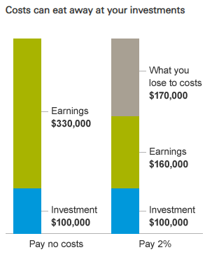
Effect of 2% fee on balance 100k start hold 25 yr 6% return Vanguard

Slide 5
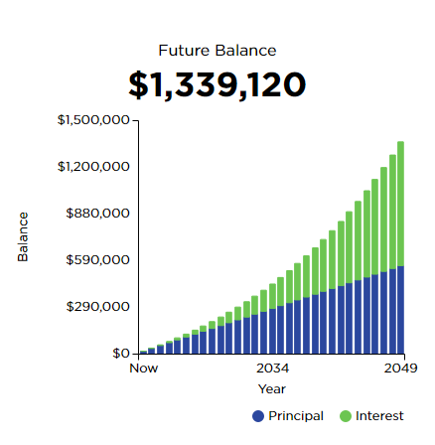
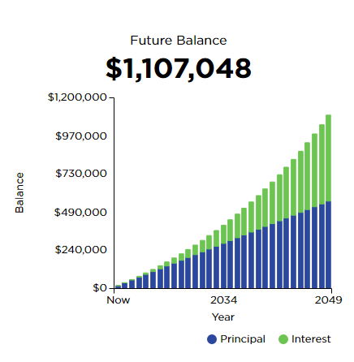
Another example
6%
0 in before age 34
1500/month until retire at age 65
6% return versus 5% versus 4%
5%
4%

Slide 6
Zero fees not practical or possible
Two main types of fees
Money manager fees and portfolio fees
Even if you do your own management, the portfolio fees remain
Managing portfolio (rebalancing, tax awareness, timing of adjustments) NOT easy
Not so much “difficult” as easy to overlook/ignore
So some fees are worth it or unavoidable

Slide 7
Fees on top of fees on top of fees
Money manager fee – biggest driver of fees
large plans <1%, small plans 1.5-2.0%
Portfolio fee
low cost index fund versus actively managed fund
*Loads (commissions), front and back
*12b-1 fees (recurring fees for commissions, advertising, etc
*service charges for transactions, loans from plan, etc
* These fees are NOT universal and driven by the money manager by choices
(Market watch, Alessandra Malito, 4/7/2018)

Slide 8
How to pay money managers (Point of the whole talk)
Most fund managers will deduct their “fees” from your portfolio quarterly
This is not mandatory, it is what is best for the money manager
They generate a bill and get paid in milliseconds – effectively NO days in A/R
If they have to bill you, they will have more “hassle” getting paid
IF you pay your fees from outside the plan, you effectively increase your fund by the amount otherwise taken from fees
IF your employer make that payment on your behalf, and then deduct your salary to offset the corporate expense, paying fees from your salary is a pre-tax payment

Slide 9
Fee paid from fund worse in later years
Hypothetical situation (worst case scenario, and not my situation at all)
Person has a portfolio worth 5,000,000 and pays 1% to manager for fees
If they contribute federal maximum in 2019 of 56000 plus catch up of 6000 (over 50)
They will have 50,000 of their 62,ooo contribution eaten by fees, or 80.6%)
If in a 2% fee situation, they LOSE 48,000 despite contributing 62,000
This is separate from the other discussion, is Asset based fee structure fair in large accounts – is there really that much more work for a 5M account as a 500K account?

Slide 10
What we did in my practice -1
Contacted out money management team and asked if we could be invoiced instead of having fees deducted from individual accounts
We waited for 5 weeks while they pretended they didn’t hear us.
We mentioned that we might be thinking about an RFP for new managers.
They agreed the next day.

Slide 11
What we did in my practice -2
Money management fees were invoiced to the company
Anyone who wanted to pay fees OUTSIDE of the plan let the CEO know of desire
Their year-end bonus was reduced by how much their plan cost the company
No individual subsidies
Pre-tax bonus reduction
Offer available to everyone equally, from employee to owner
Doesn’t help retirees, as they have no bonus or salary to “reduce”
Our situation is better than the example (0.33% asset based fees)
This doesn’t cover fund fees (for example, Vanguard S&P 500 index ETF charges .04%)

Slide 12
Final thoughts (addl topics to mull)
Roth versus traditional pretax contribution
Corporate roth does NOT have income limitation (like the individual version)
Two step personal IRA to Roth IRA transaction (if have run out of other funds)

Slide 13
Retirement fund fees reallocation results in reduced expense of portfolio over time
Eric Brandser

