Slide 1
Confidence Calibration in Radiology
Behrang Amini

Slide 2
How good a radiologist am I?

Slide 3
Do I talk good?

Slide 4
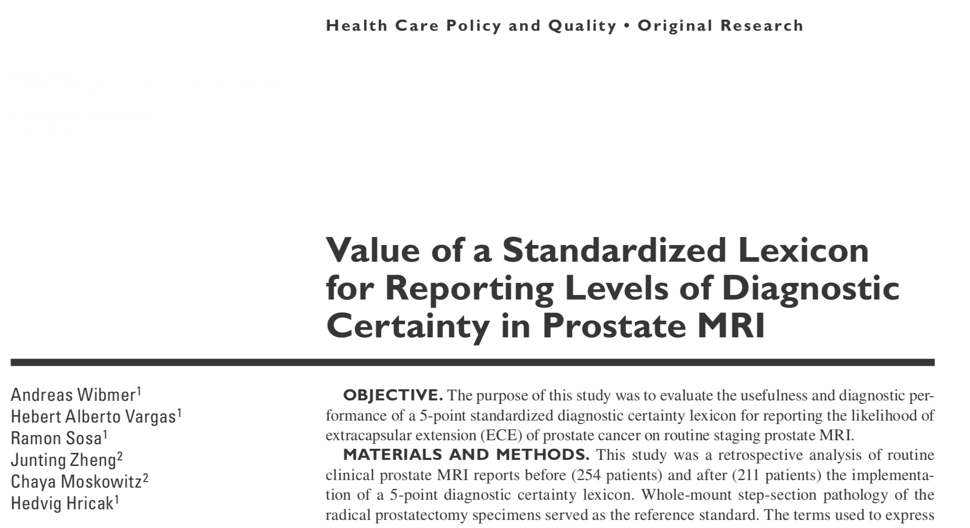

Slide 5
Do my words mean anything?

Slide 6
Words → %
Word | Percentage
Is | 100%
Is not | 0%

Slide 7
Words → %
Word | Percentage
Is | 100%
Possibly | 1-99%
May | 1-99%
Can’t exclude | 1-99%
Is not | 0%

Slide 8
How well-calibrated am I?

Slide 9
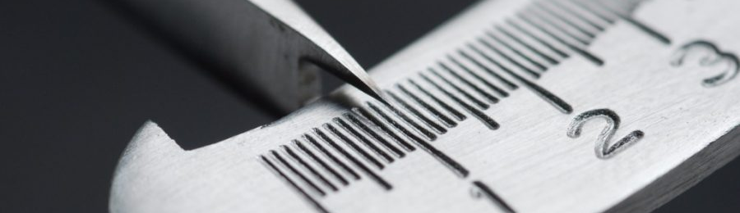
Calibration?

Slide 10
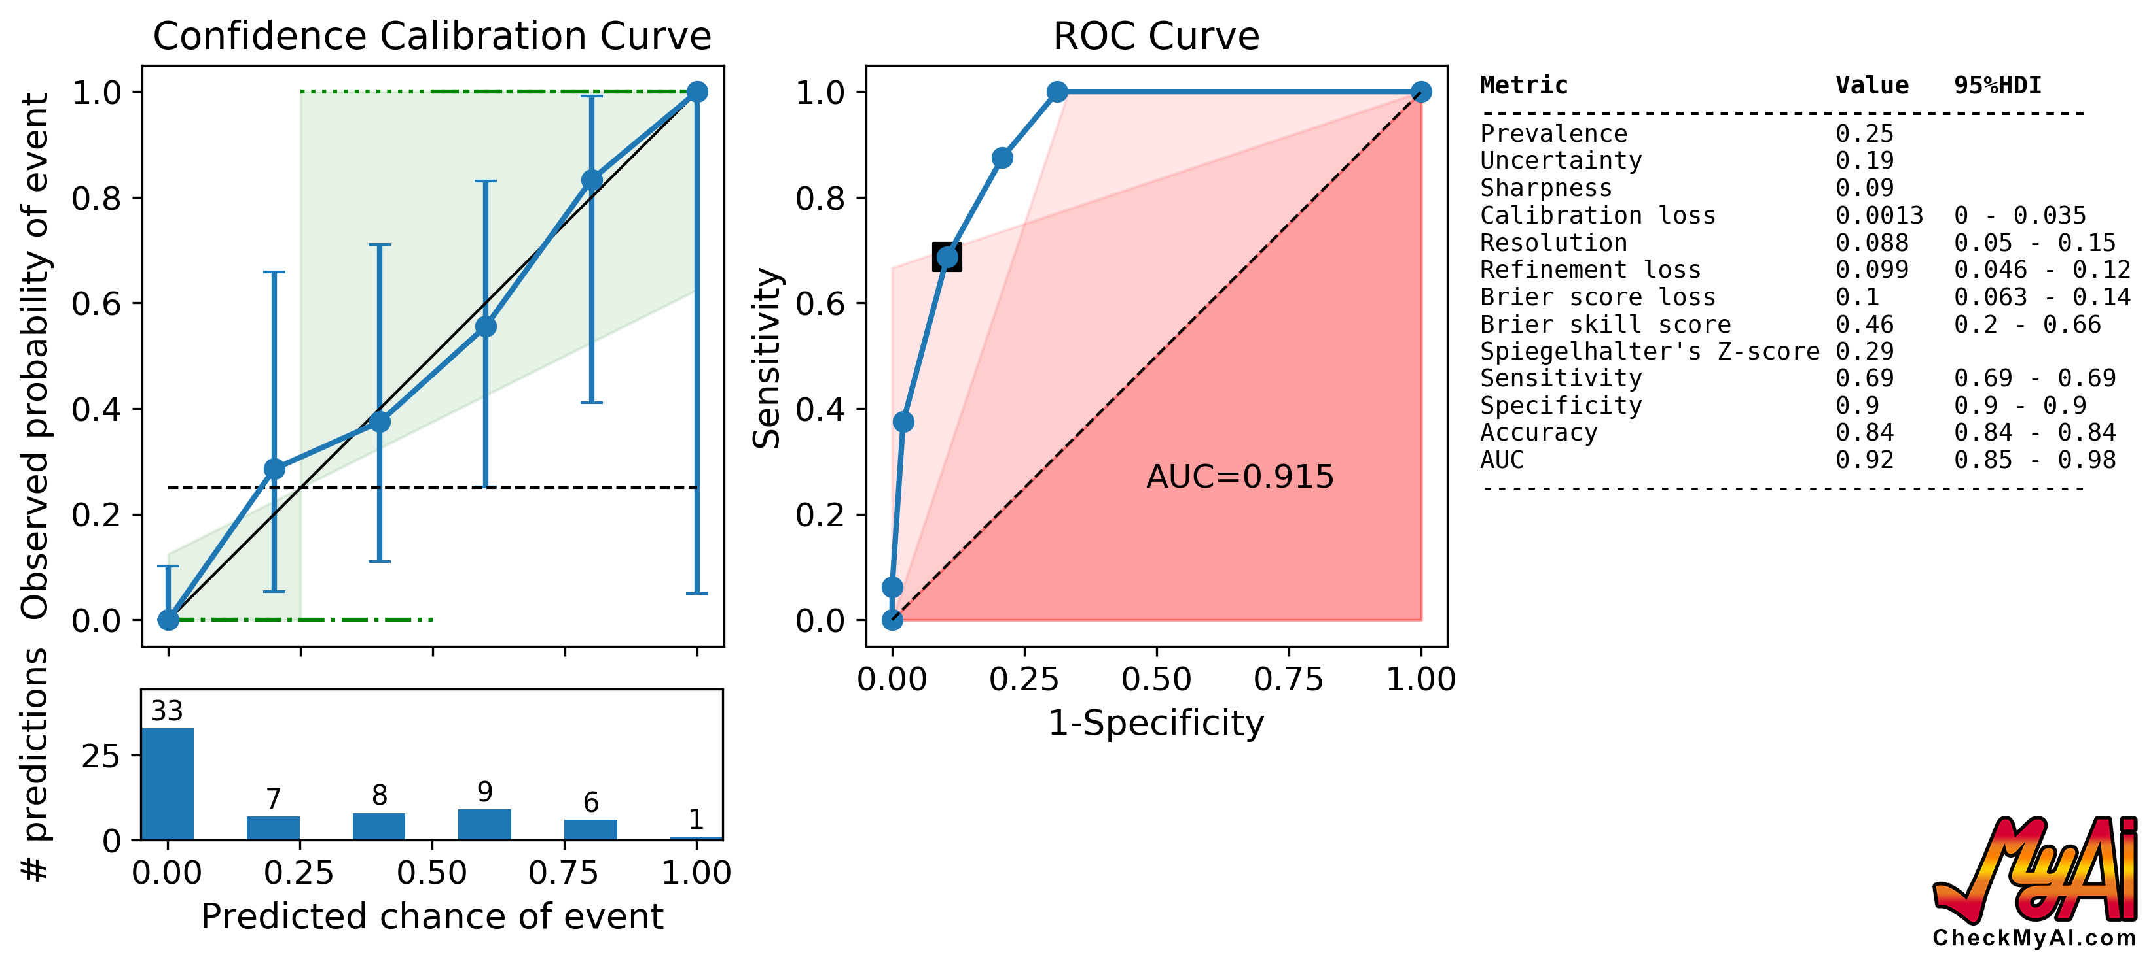

Slide 11
Predicted chance of event
 | 0 | 0.2 | 0.4 | 0.6 | 0.8 | 1
0
1
Out-come

Slide 12
Predicted chance of event
 | 0 | 0.2 | 0.4 | 0.6 | 0.8 | 1
0 | 33 | 5 | 5 | 4 | 1 | 0
1 | 0 | 2 | 3 | 5 | 5 | 1
Out-come

Slide 13
Predicted chance of event
 | 0 | 0.2 | 0.4 | 0.6 | 0.8 | 1
0 | 33 | 5 | 5 | 4 | 1 | 0
1 | 0 | 2 | 3 | 5 | 5 | 1
Sum | 33 | 7 | 8 | 9 | 6 | 1
Out-come

Slide 14
Predicted chance of event
 | 0 | 0.2 | 0.4 | 0.6 | 0.8 | 1
0 | 33 | 5 | 5 | 4 | 1 | 0
1 | 0 | 2 | 3 | 5 | 5 | 1
Sum | 33 | 7 | 8 | 9 | 6 | 1
Out-come
total = 33 + 7 + 8 + 9 + 6 + 1
total = 64
positives = 0 + 2 + 3 + 5 + 5 + 1
positives = 16
prevalence = 16/64
prevalence = 0.25

Slide 15
Predicted chance of event
 | 0 | 0.2 | 0.4 | 0.6 | 0.8 | 1
0 | 33 | 5 | 5 | 4 | 1 | 0
1 | 0 | 2 | 3 | 5 | 5 | 1
Out-come

Slide 16
Predicted chance of event
 | 0 | 0.2 | 0.4 | 0.6 | 0.8 | 1
0 | 33 | 5 | 5 | 4 | 1 | 0
1 | 0 | 2 | 3 | 5 | 5 | 1
Out-come
 | 0/33 | 2/7 | 3/8 | 5/9 | 6/5 | 1/1
 |  | 0.29 | 0.38 | 0.56 | 0.83 | 1

Slide 17
Predicted chance of event
 | 0 | 0.2 | 0.4 | 0.6 | 0.8 | 1
0 | 33 | 5 | 5 | 4 | 1 | 0
1 | 0 | 2 | 3 | 5 | 5 | 1
Out-come
 | 0/33 | 2/7 | 3/8 | 5/9 | 6/5 | 1/1
 | 0 | 0.29 | 0.38 | 0.56 | 0.83 | 1

Slide 18
Predicted chance of event
 | 0 | 0.2 | 0.4 | 0.6 | 0.8 | 1
0 | 33 | 5 | 5 | 4 | 1 | 0
1 | 0 | 2 | 3 | 5 | 5 | 1
Out-come
Observed probability of event
 | 0/33 | 2/7 | 3/8 | 5/9 | 6/5 | 1/1
 | 0 | 0.29 | 0.38 | 0.56 | 0.83 | 1

Slide 19
Predicted chance of event
 | 0 | 0.2 | 0.4 | 0.6 | 0.8 | 1
0 | 33 | 5 | 5 | 4 | 1 | 0
1 | 0 | 2 | 3 | 5 | 5 | 1
Out-come
Observed probability of event
 | 0/33 | 2/7 | 3/8 | 5/9 | 6/5 | 1/1
 | 0 | 0.29 | 0.38 | 0.56 | 0.83 | 1

Slide 20
Predicted chance of event
 | 0 | 0.2 | 0.4 | 0.6 | 0.8 | 1
0 | 33 | 5 | 5 | 4 | 1 | 0
1 | 0 | 2 | 3 | 5 | 5 | 1
Out-come
Observed probability of event
 | 0/33 | 2/7 | 3/8 | 5/9 | 6/5 | 1/1
 | 0 | 0.29 | 0.38 | 0.56 | 0.83 | 1

Slide 21
Predicted chance of event
 | 0 | 0.2 | 0.4 | 0.6 | 0.8 | 1
0 | 33 | 5 | 5 | 4 | 1 | 0
1 | 0 | 2 | 3 | 5 | 5 | 1
Out-come
Observed probability of event
 | 0/33 | 2/7 | 3/8 | 5/9 | 6/5 | 1/1
 | 0 | 0.29 | 0.38 | 0.56 | 0.83 | 1

Slide 22
Predicted chance of event
 | 0 | 0.2 | 0.4 | 0.6 | 0.8 | 1
0 | 33 | 5 | 5 | 4 | 1 | 0
1 | 0 | 2 | 3 | 5 | 5 | 1
Out-come
Observed probability of event
 | 0/33 | 2/7 | 3/8 | 5/9 | 6/5 | 1/1
 | 0 | 0.29 | 0.38 | 0.56 | 0.83 | 1

Slide 23
Predicted chance of event
 | 0 | 0.2 | 0.4 | 0.6 | 0.8 | 1
0 | 33 | 5 | 5 | 4 | 1 | 0
1 | 0 | 2 | 3 | 5 | 5 | 1
Out-come
Observed probability of event
 | 0/33 | 2/7 | 3/8 | 5/9 | 6/5 | 1/1
 | 0 | 0.29 | 0.38 | 0.56 | 0.83 | 1

Slide 25
http://CheckMyAi.com/

Slide 26
How to interpret curves?

Slide 27
Line of optimal calibration

Slide 28
Line of no resolution
0.25 (Prev.)

Slide 29
Lines of optimal resolution
0.25 (Prev.)

Slide 30
Lines of optimal accuracy
0.5

Slide 31
Lines of zero skill
0.5

Slide 32
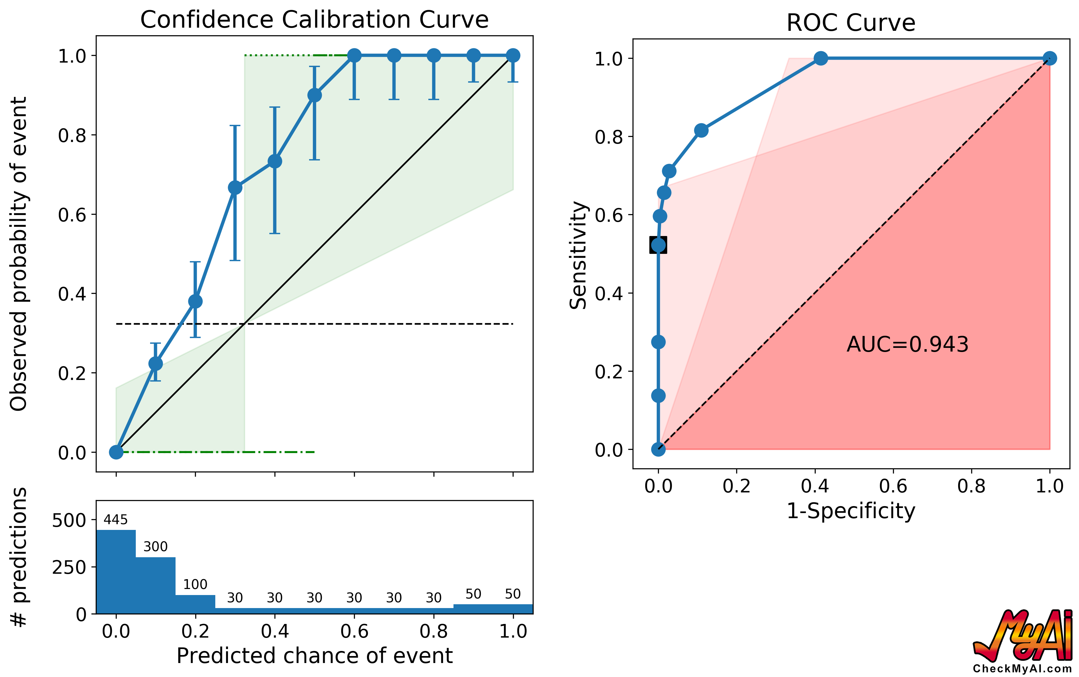
Under-confident
Notes:
Under-confident

Slide 33
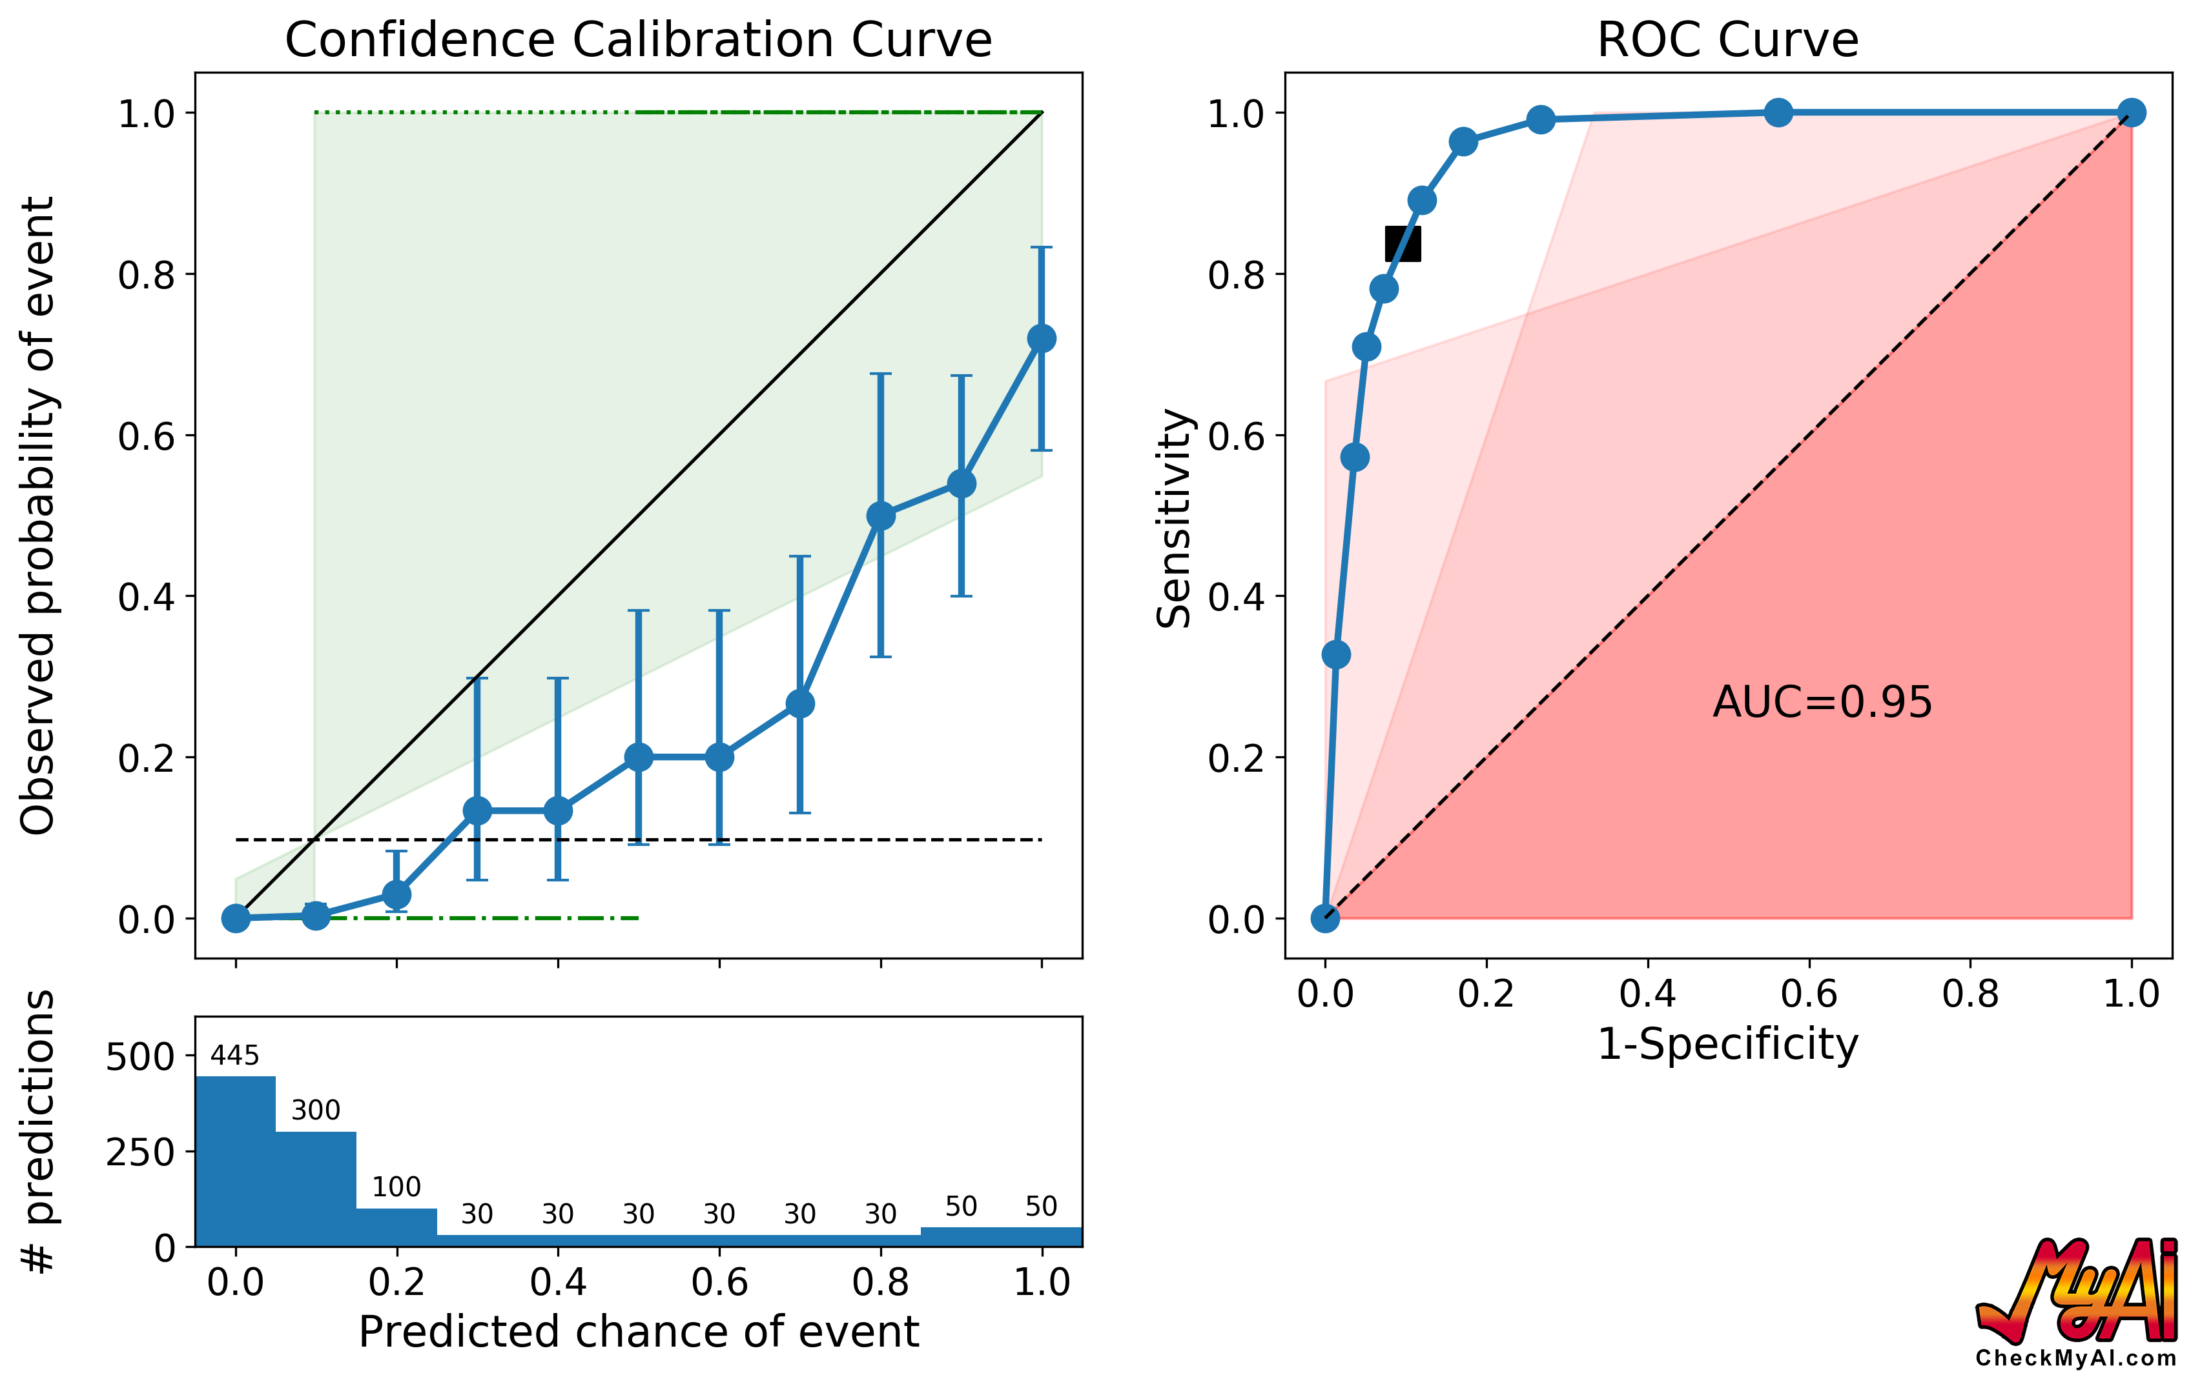
Over-confident
Notes:
Under-confident

Slide 34
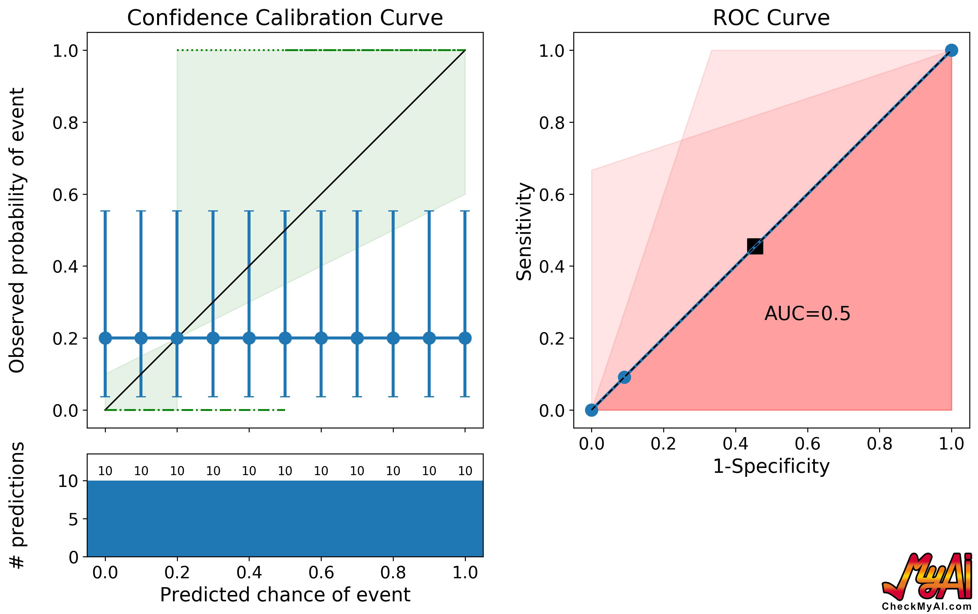
No resolution

Slide 35
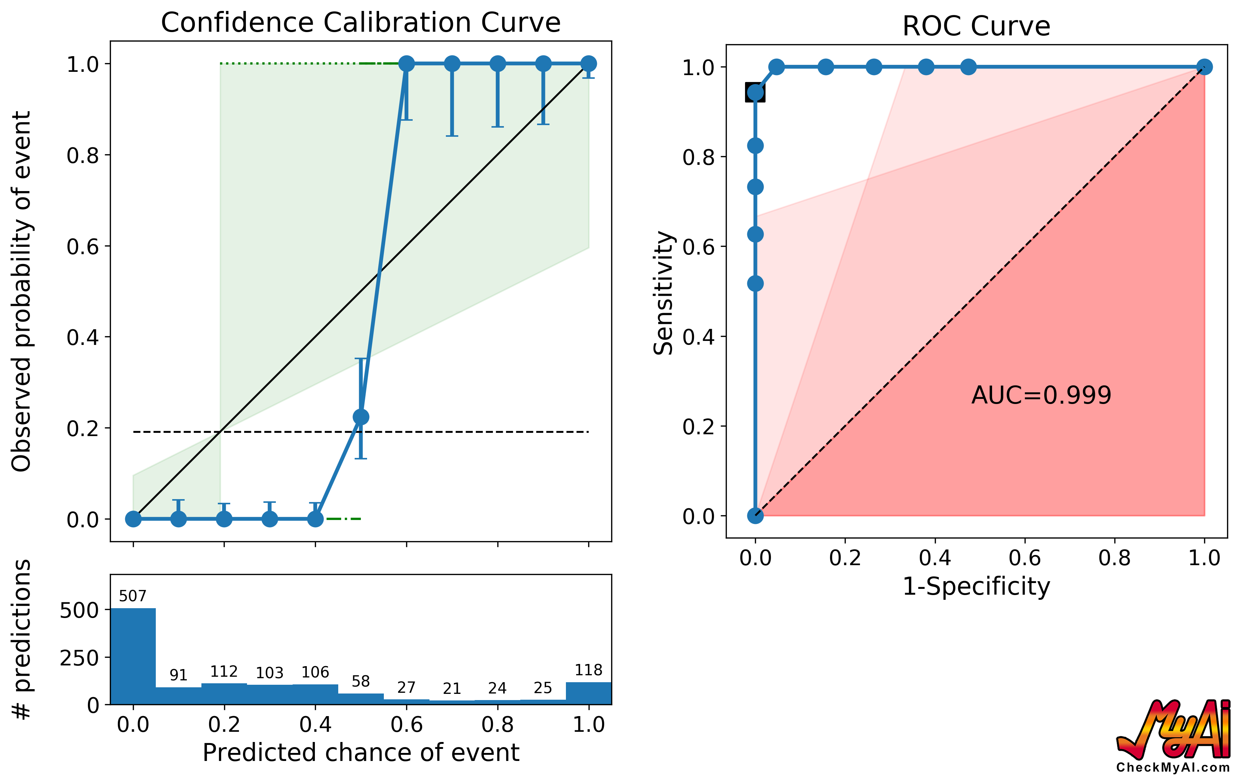
Optimal accuracy

Slide 36
How do we get there?

Slide 38
0%
10%
30%
50%
70%
90%
100%

Slide 39
0%
0%
10%
30%
50%
70%
90%
100%
0%
10%
30%
50%
70%
90%
100%

Slide 40
0%
10%
30%
50%
70%
90%
100%
10%

Slide 41
0%
10%
30%
50%
70%
90%
100%
30%

Slide 42
0%
10%
30%
50%
70%
90%
100%
50%

Slide 43
0%
10%
30%
50%
70%
90%
100%
70%

Slide 44
0%
10%
30%
50%
70%
90%
100%
90%

Slide 45
0%
10%
30%
50%
70%
90%
100%
100%

Slide 46
1 year later
41 patients with > 6 months of follow-up

Slide 47
How well-calibrated am I?

Slide 48
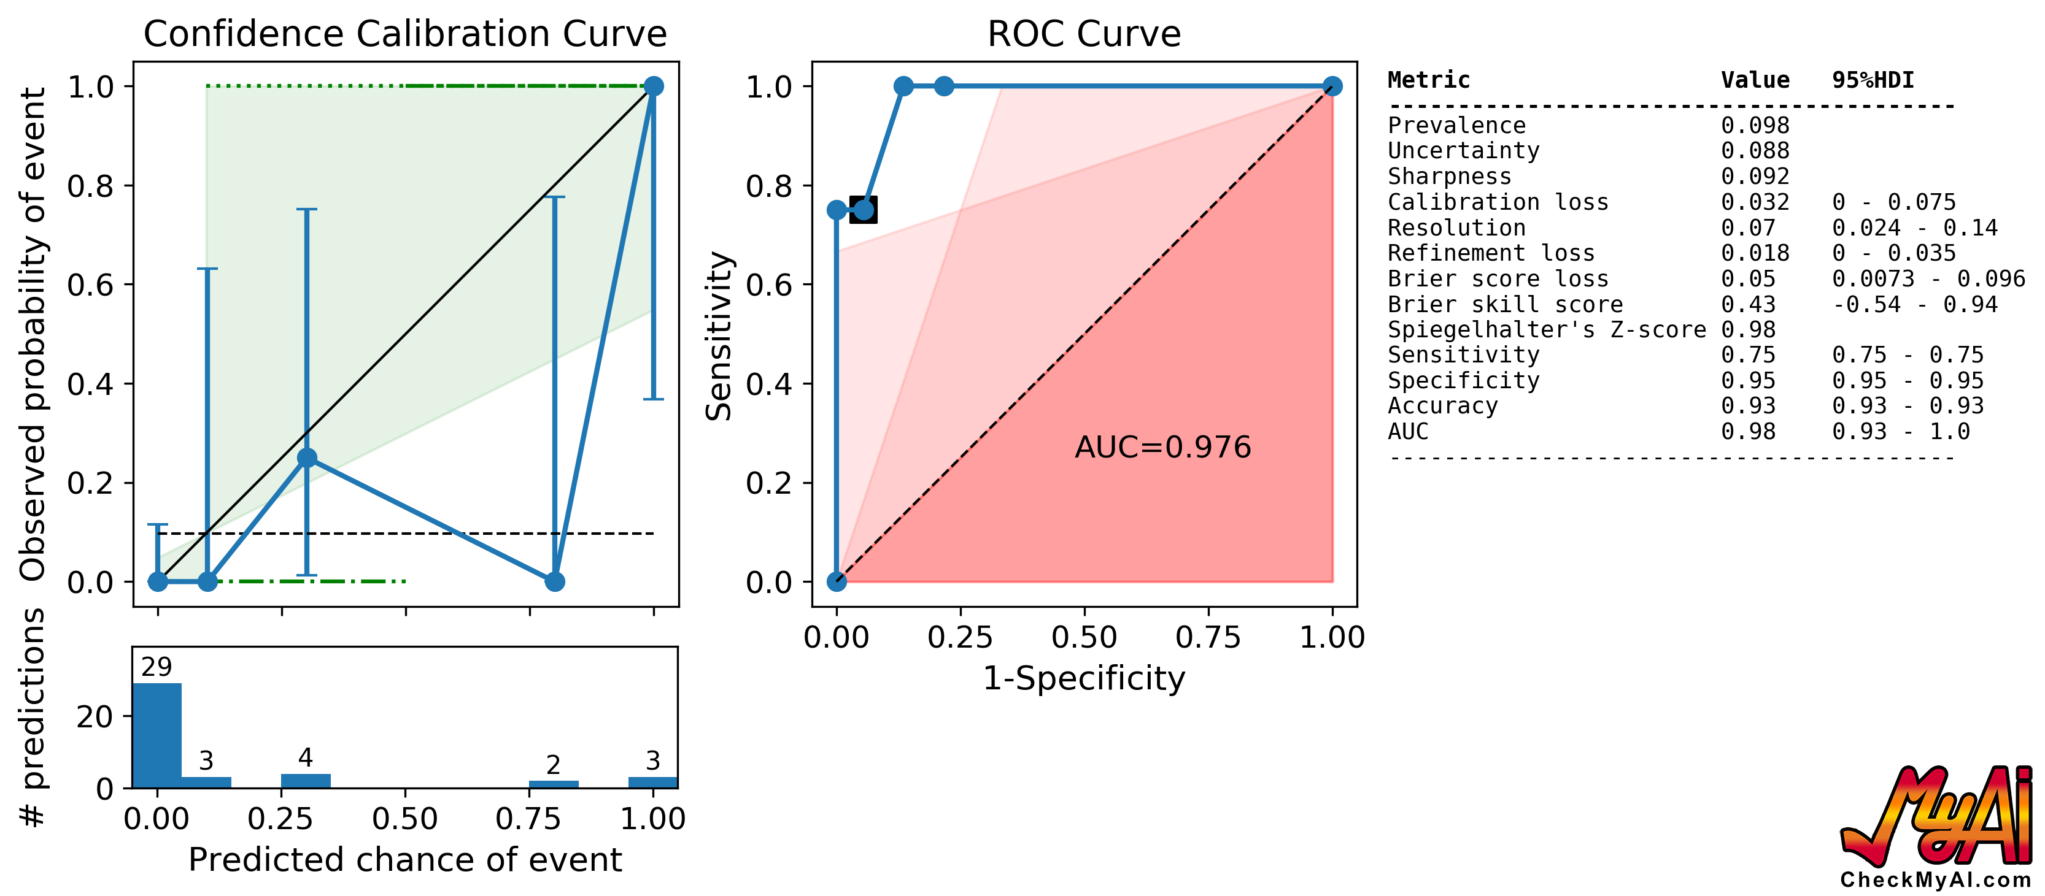

Slide 49
“When I’m 80% sure there’s recurrence, I over-call recurrence”
“Findings concerning for locally recurrent disease”

Slide 50
How easy is this?

Slide 51
0%
10%
30%
50%
70%
90%
100%
70%

Slide 52
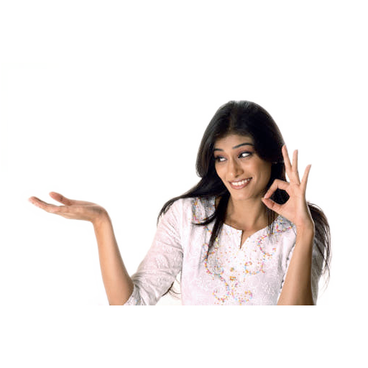
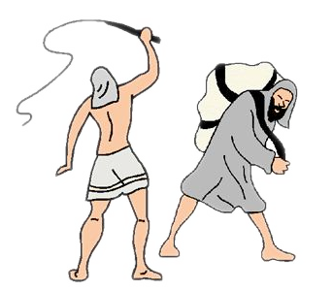

Slide 54
bamini@mdanderson.org

